Slide 1
NGC4383
J.E Campagne
14
Nov. 11

Slide 2
Data
Date 2011-10-22
Cycles 1-15 foreseen but 12-15 only !
SCA156855.171
Std BAO DAQ
Analysis Std: median filter on paquets only

Slide 3
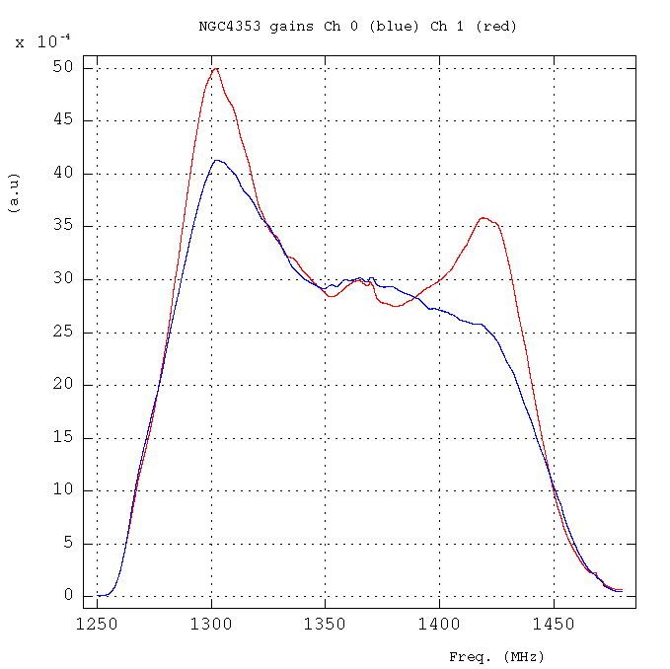
Gains cycle #13
Gains different shape as I was expecting. But confirmed by Ana that they have changed since 7th July…

Slide 4
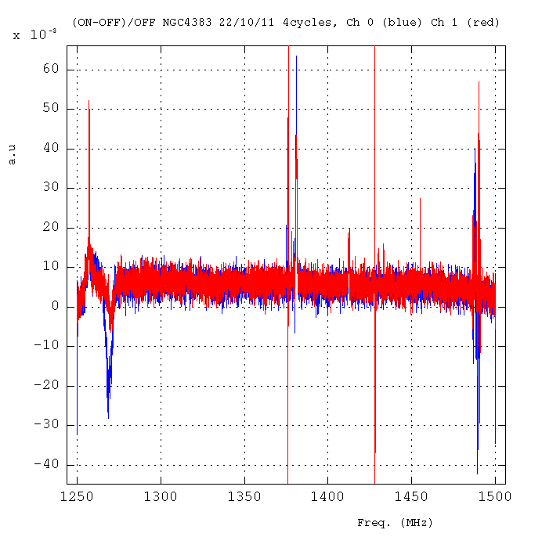
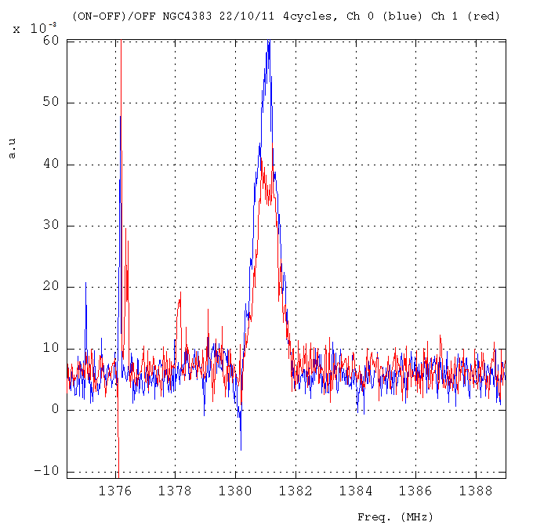
RFI
HI-line

Slide 5
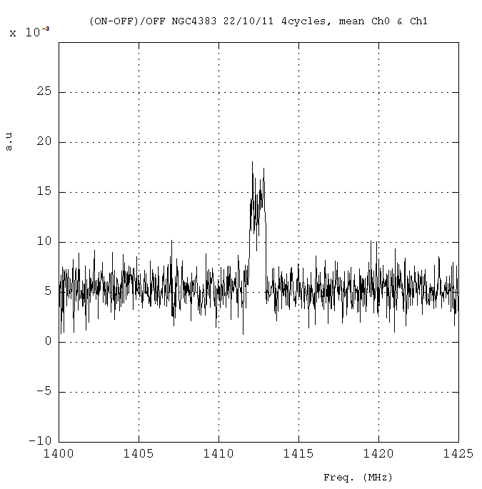
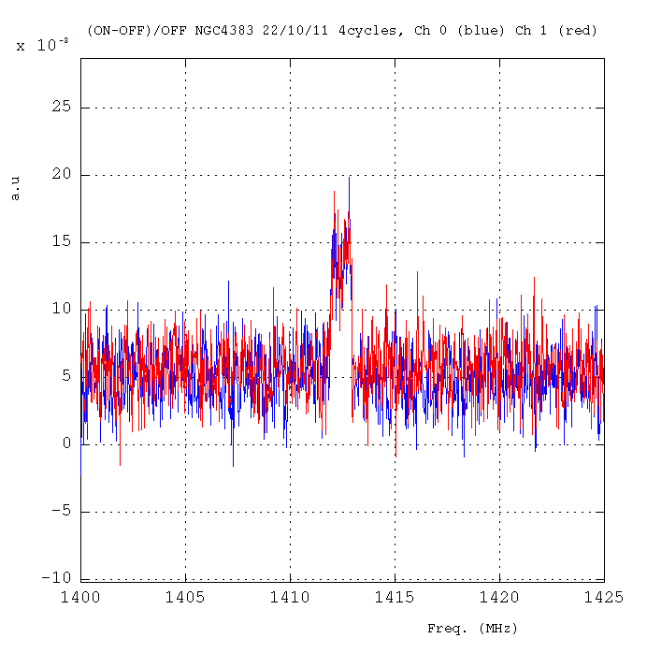
Continuum & line
Zoom of HI line
Continuum: ~ 44.3 ± 4.1 mJy
HI Line:
width ~213km/s ~1MHz
int. 48.4 ± 5.1 Jy km/s ~230mJy
A. Chung et al, VLA IMAGING OF VIRGO SPIRALS IN ATOMIC GAS (VIVA). I., The Astronomical Journal, 138:1741–1816, 2009 December
THE ATLAS AND THE Hi PROPERTIES
Mean of Ch0 & Ch 1
1MHz
Ch 0 = Ch 1
1420.20/(1+0.0057) = 1412.15 MHz = 1700 km/s OK

Slide 6
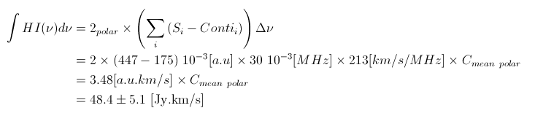

Other hypothesis: takes the HI line intensity for calibration
Integral in the range [1412-1413] MHz
Then
So, the fluctuations of the baseline [1390-1410]MHz of the mean polar give
Better…
But then the “0” is not “0” in the ON-OFF plot of the mean polar…
x=+2.1 10⁻³ au or +29.4mJy (continuum confusion ?)

Slide 7
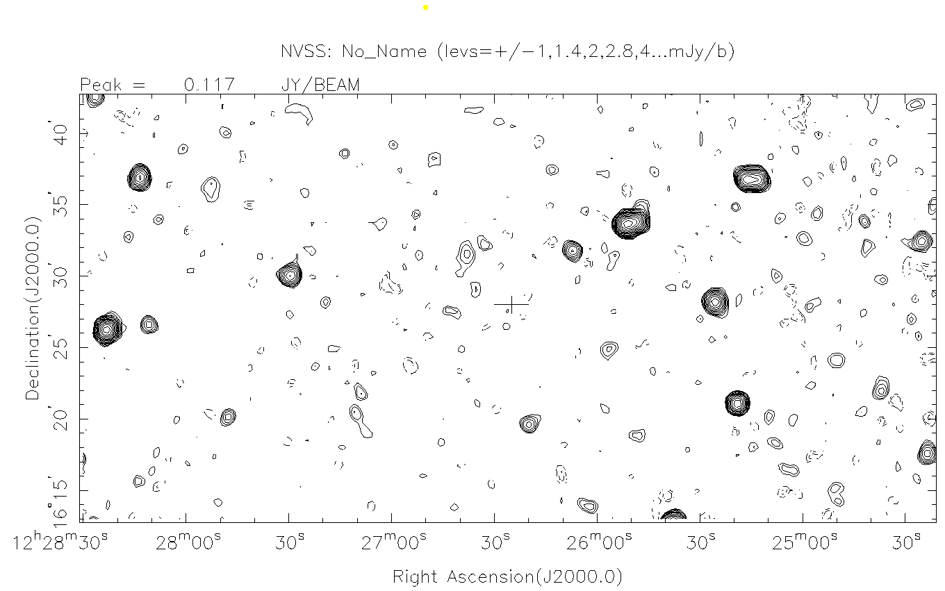
BEAM FWHM: 4’ (RA) x 22’ (DEC) @ 21cm
OFF
ON
1 x FWHM

Slide 8


Take the mean of Ch0 & Ch 1
Baseline [1390-1410]MHz = 5.3 10⁻³ [a.u] and if one uses the Continuum level
Integral in the range [1412-1413] MHz
= 447 10⁻³ [a.u] * 8.4 [Jy/a.u] * 30 [kHz] * 213[km/s /MHz]
= 24 [Jy.km/s]
Continuum contribution
= 44.3 [mJy] * 1 [MHz] * 213 [km/s/MHz]
= 9.5 Jy.km/s
Pb!!!
Total HI-Line : 2 * (24-9.5) = 29 [Jy.km/s]

