Slide 1
3C161 Drift Scan
J.E Campagne
16/01/2012

Slide 2
Data
2 runs 2011-12-09
  3C161 : 0:57:21 start
    3 cycles/4 available 2-4
  3C161B : 1:11:50
    7 cycles/9 available 3-9
1 cycle = 170 sec ON-like
Add the images time-freq. and use the first 30sec as “0”
No use of DAB

Slide 3
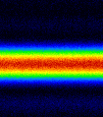
Image time-Freq.

Slide 4
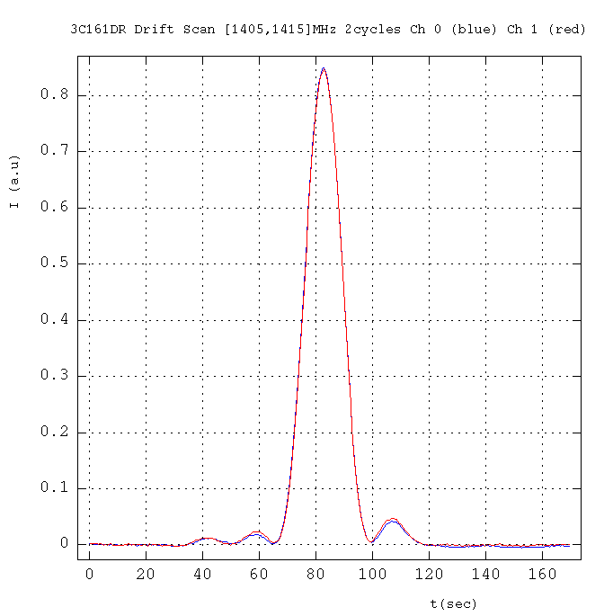
Time evolution
Timing: 8.22kHz

Slide 5
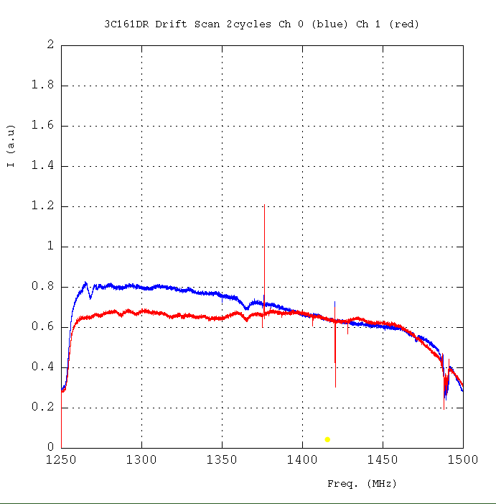
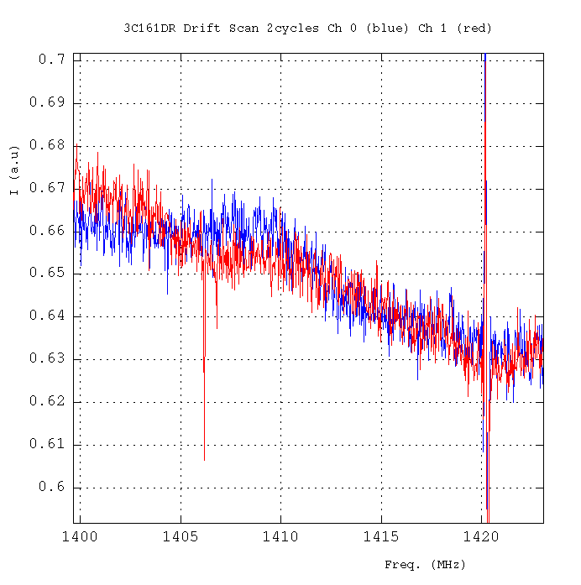
Spectra integrated during the FWHM of the drift.

Slide 6
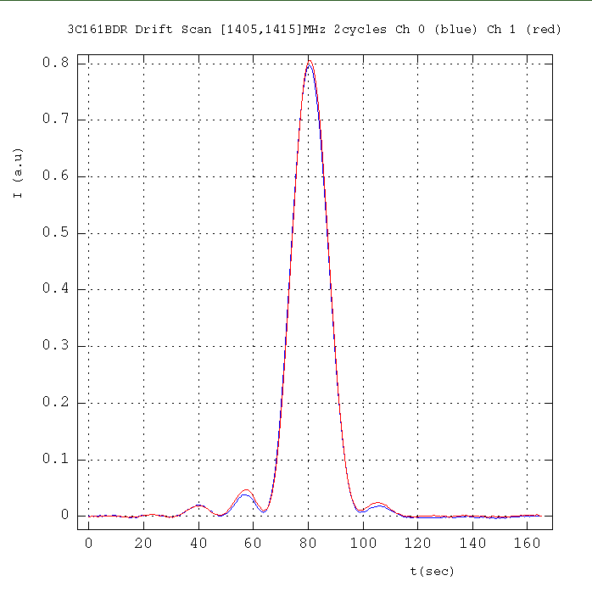
The 2 drifts ±3% effect
The freq. spectrum remains the same

Slide 7
Calibration
3C161 0624-05 (Baars et al 1977)
----------------------------------------------
Freq MHz 1250 1280 1380 1410
Flux Jy 20,636 20,294 19,233 18,937
----------------------------------------------
Ott et al. , 1994
Freq. Flux date Obs.
MHz Jy
-------------------------------------
1408 18.58 (0.09) Feb. 1990

