Slide 1
Noise
J.E Campagne
1/2/12

Slide 2
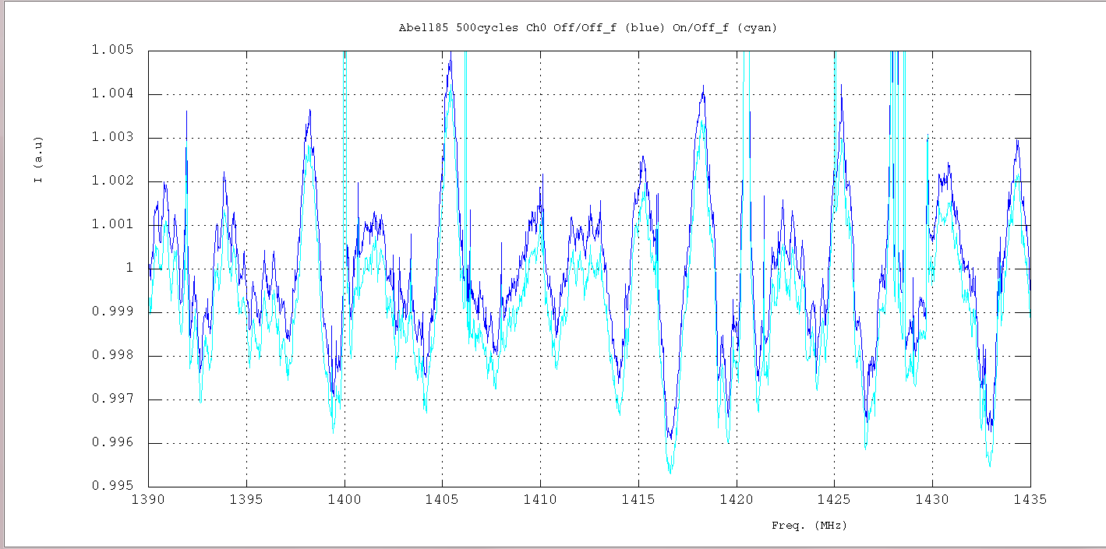
Zoom of the Abell85 normalized spectra obtained with 500cycles
Ch. 0 (On & Off)/Off_filtered
2 “oscillations” : ~2.5MHz (large amp.) & ~500kHz (small amp.)

Slide 3
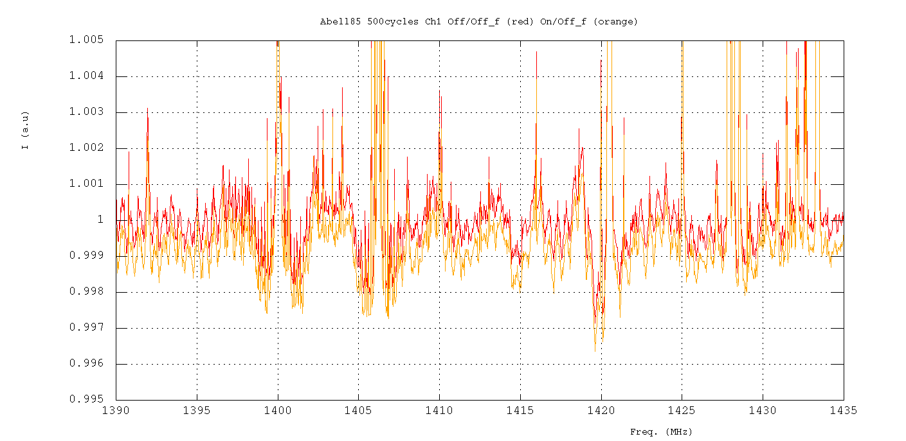
Ch. 1 (On & Off)/Off_filtered
Only 1 “oscillation” : ~500kHz (small amp.)

Slide 4
Some facts
The large oscillations are visible with only few data taking < 1min.
The small ones need summation so normalized spectra are the gain change…
The noises are present on all data: Abell, 3C, NGC.
The 500kHz noise was in fact present since Juil. 2010 in the UGC4358 on non normalized spectra for both channels.

Slide 5
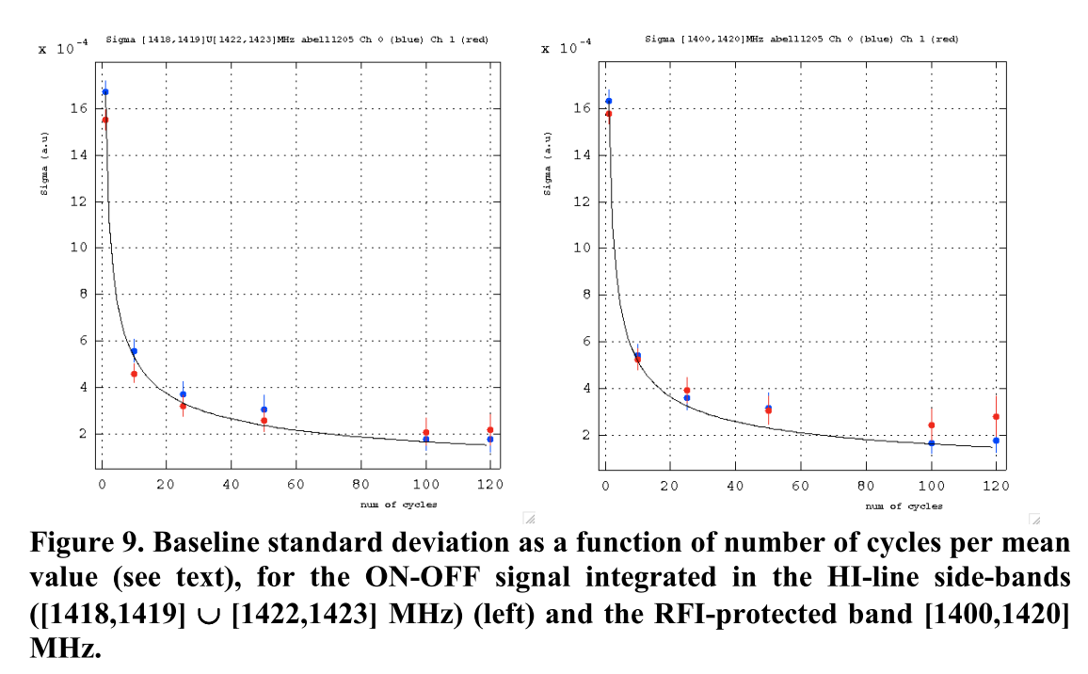
σ
Δf = 4MHz
Δf = 20MHz
One would have expected 1/√5 improvement!!!
Extracted from Abell1205 MEMO 23/11/11

Slide 6
Data processing on Irods @ CCIN2P3
Median ov. 5120 BAO paq. ON/Gain or OFF/Gain
Mean of 5 medians => med. spectrum (FITS files)
Mean on each cycle
For each cycle (ON-OFF)/OFF_f
  Result of (ON/G-OFF/G)/(OFF/G)_f
  G=Gain med. Filtered 3MHz
  (OFF/G)_f= (OFF/Gain) med. Filtered 2MHz
For each cycle too < (ON-OFF)/OFF_f > ov. [ν_{1,} ν₂]

Slide 7
Sigma
Estimation
<ON/Gain>(ν) ~ <OFF/Gain>(ν) ~ 1 (no signal & def.)
σ[OFF/OFF_f]  σ[ON/OFF_f] (at leats it is a fact)
σ_{med} =med/(ln2 √N_{paq}) and med[ON/Gain] ~ med[OFF/Gain] ~1
(a.u)
1 cycle
5
~9
5120
σ (1cycle) ∝ 1/√Δf and σ(n cycles) ∝ σ(1)/√n

Slide 8
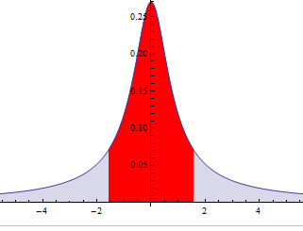
Evolution of sigma computation
The sigma may be affected by the noise (see Ana’s talk)
To avoid artifact we use now the inter quartile range IQR normalized
IQR for Normal dist. with σ=1
50%

