Slide 1
Abell85, 2440, 1205 zoom on HI
J.E Campagne
1/2/12

Slide 2
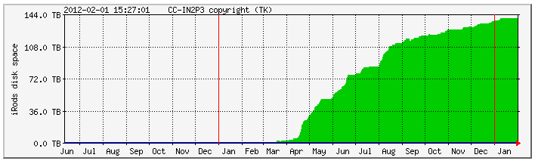
Data
500 cycles ON-OFF Abell85
240 cycles ON-OFF Abell2440
700 cycles ON-OFF Abell1205
1 cycle 2min total: 30sec x 30% ON + 30sec x 30% OFF

Slide 3
Data processing on Irods @ CCIN2P3 (short list)
Median ov. 5120 BAO paq. ON/Gain or OFF/Gain
Mean of 5 medians => med. spectrum (FITS files)
Mean on each cycle
For each cycle (ON-OFF)/OFF_f
Result of (ON/G-OFF/G)/(OFF/G)_f
G=Gain med. Filtered 3MHz
(OFF/G)_f= (OFF/Gain) med. Filtered 2MHz
For each cycle too < (ON-OFF)/OFF_f > ov. [ν_{1,} ν₂]
Limitation due to batch queue parameters although we are using LONG & HUGE ! In particular: median filtering limited ~5120 paq; cycles with 170sec (Drift) are the maximum but for ON-OFF it could be non-particable as then we should split the run into individual cycles and we are limited by <20 simultaneous jobs accessing Irods.

Slide 4
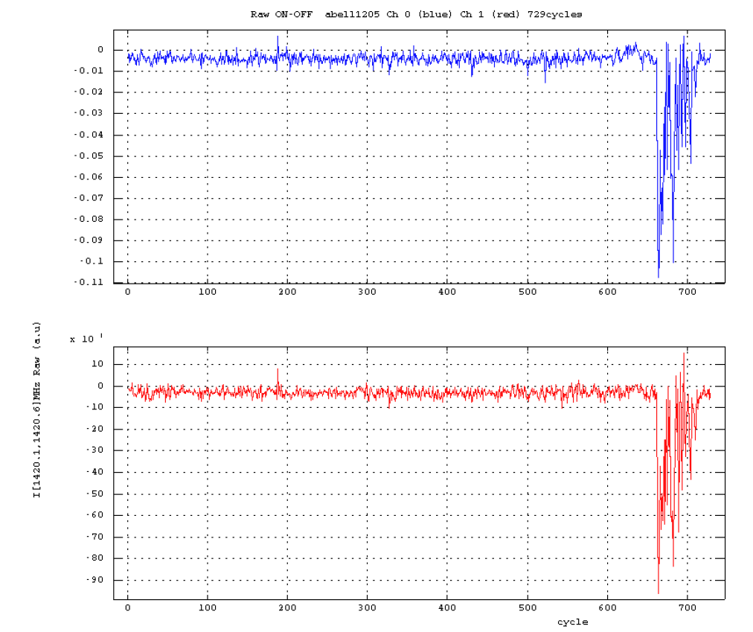
Abell 1205: DAQ stability
22/08/11-22/09/11
[1420.1,1420.6]MHz vs cycle

Slide 5
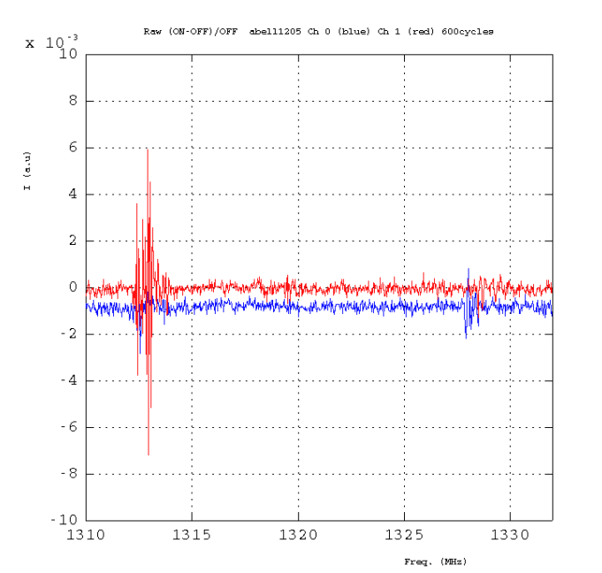
Abell1205
(ON-OFF)/OFF_f
600 cycles

Slide 6
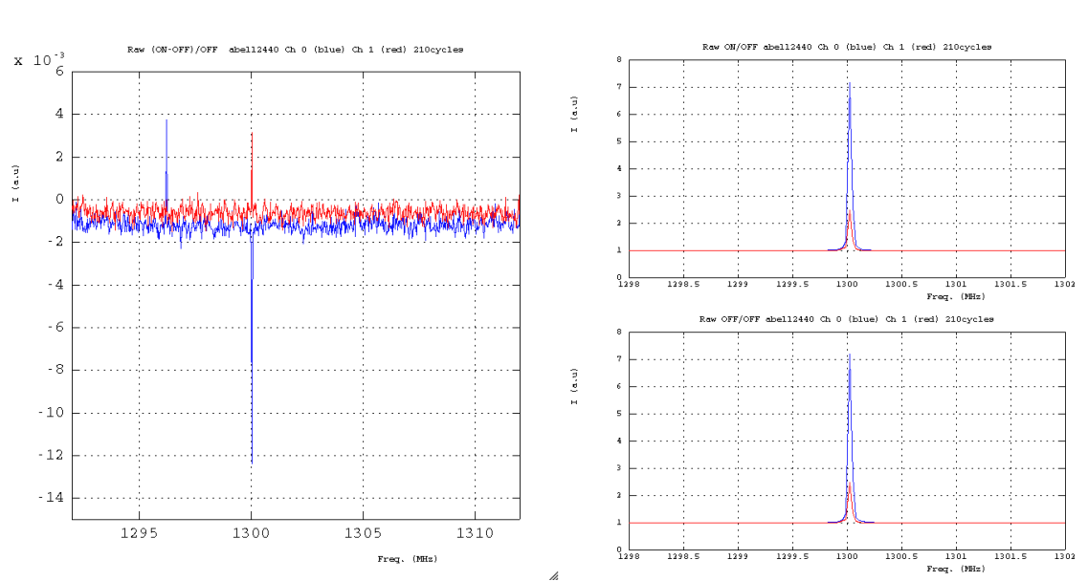
Abell2440
ON/OFF_f
(ON-OFF)/OFF_f
OFF/OFF_f
210 cycles

Slide 7
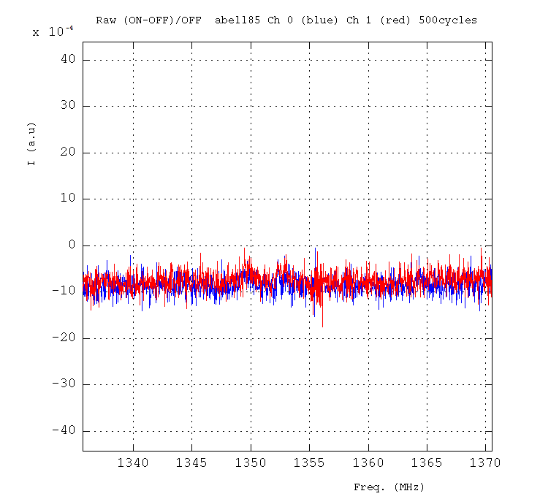
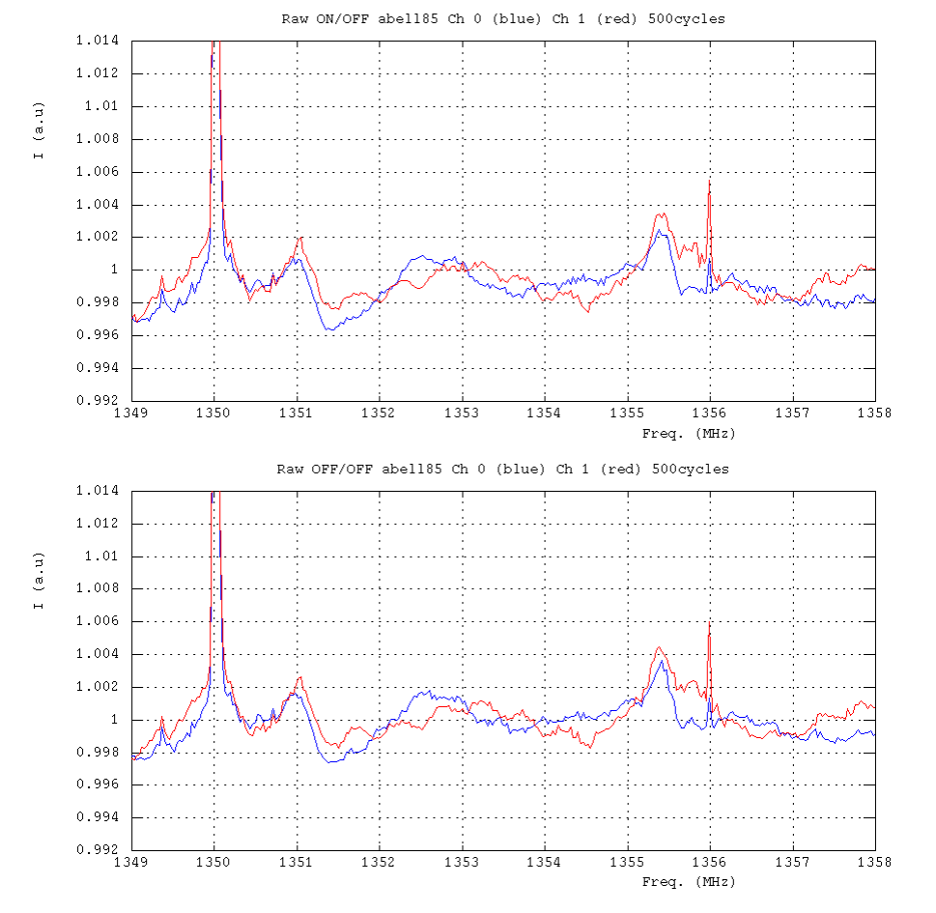
Abell85
(ON-OFF)/OFF_f
500 cycles
ON/OFF_f
OFF/OFF_f

