Slide 1
Amas Processing Status
J.E Campagne (LAL) 3/2/12-Meudon
Data proc. Status
Calibrator sources analysis
Abellxyz: zoom freq. band for HI signal
Noise: introduction to A.S Torrento’s talk

Slide 2
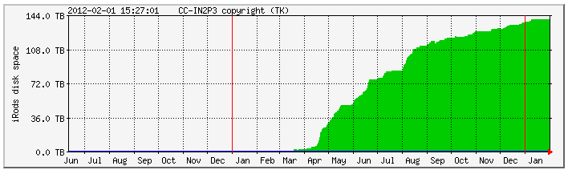
Data
500 cycles ON-OFF Abell85
240 cycles ON-OFF Abell2440
900 cycles ON-OFF Abell1205
Few 3C161, 3C273, NGC4383 runs both ON-OFF & DR
1 cycle ON-OFF 2min total: 30sec x 30% ON + 30sec x 30% OFF
1 cycle DR ~3min total: 170sec x 30% x corr. fact

Slide 3
Data processing on Irods @ CCIN2P3 (short list)
Median ov. 5120 BAO paq. ON/Gain or OFF/Gain
Mean of 5 medians => med. spectrum (FITS files)
Mean on each cycle
For each cycle (ON-OFF)/OFF_f
Result of (ON/G-OFF/G)/(OFF/G)_f
G=Gain med. Filtered 3MHz
(OFF/G)_f= (OFF/Gain) med. Filtered 2MHz
For each cycle too < (ON-OFF)/OFF_f > ov. [ν_{1,} ν₂]
Limitation due to batch queue parameters although we are using LONG & HUGE ! In particular: median filtering limited ~5120 paq; cycles with 170sec (Drift) are the maximum but for ON-OFF it could be non-particable as then we should split the run into individual cycles and we are limited by <20 simultaneous jobs accessing Irods.

Slide 4
Calibrator Sources 3C273, 3C261, NGC4383

Slide 5
3C161 Drift Scan
158451.171 & 158452.171

Slide 6
Data
2 runs 2011-12-09
3C161 : 0:57:21 start
3 cycles/4 available 2-4
3C161B : 1:11:50
7 cycles/9 available 3-9
1 cycle = 170 sec ON-like
Add the images time-freq. and use the first 30sec as “0”
No use of DAB

Slide 7
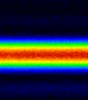
Image time-Freq.

Slide 8
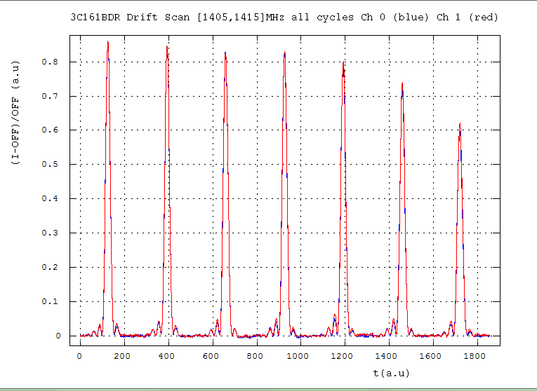
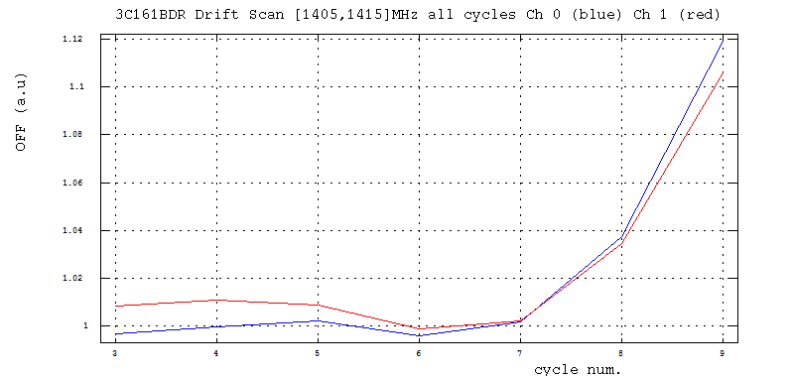
Peak int. & Tsys variations: 3C161B
−25%
3
4
5
6
7
8
9
+10%
Tsys/Gain (au)
[1405,1415]MHz
+2%

Slide 9
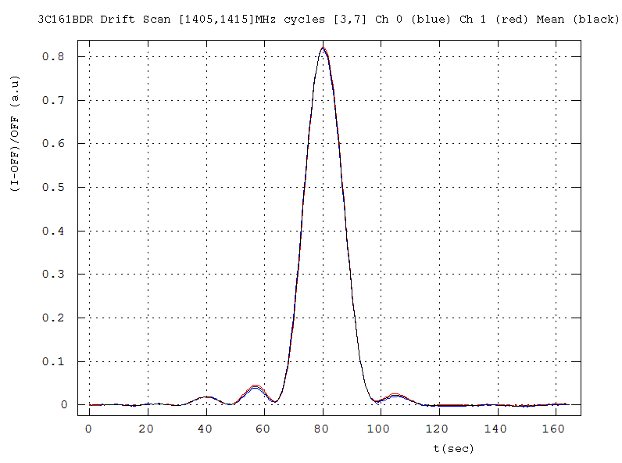
I_{peak} ~ 2x0.82 a.u
Timing: 8.22kHz

Slide 10
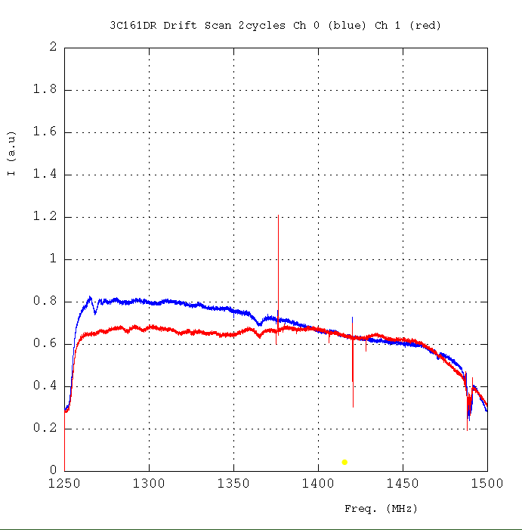
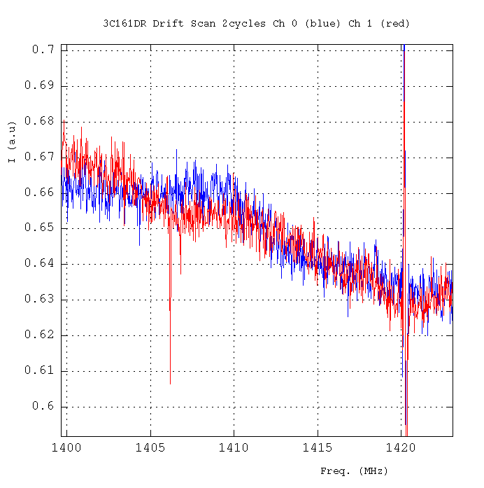
Spectra integrated during the FWHM of the drift.
Differences wrt the 3C273 spectra
Polarization?

Slide 11

Calibration
3C161 0624-05 (Baars et al 1977) ---------------------------------------------- Freq MHz 1250 1280 1380 1410 Flux Jy 20,636 20,294 19,233 18,937 ----------------------------------------------
1410MHz
2 x 0.819 x C = 18.58
11.3 ± 0.3 Jy/a.u (*)
Ott et al. , 1994
3C161
Freq. Flux date Obs. MHz Jy ------------------------------------- 1408 18.58 (0.09) Feb. 1990
3% from litt. Meas.
(*): be careful this is to be applied to the SUM of the 2 polarizations, not the MEAN

Slide 12
3C273 – 2011/12/09 ON/OFF & Drift
158461.171 & 158462.171

Slide 13
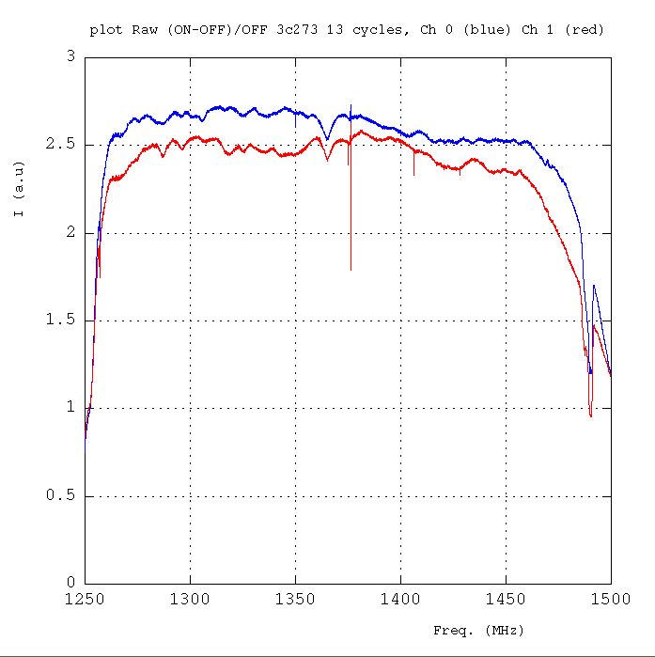
(ON-OFF)/OFF-filtered
13 cycles 30sec
each (30% eff.)

Slide 14
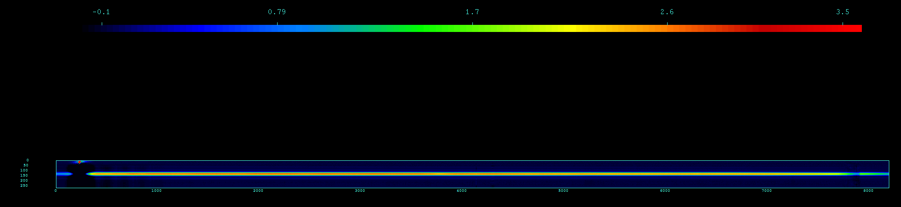
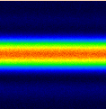
Drift Scan: I(time, frequency)

Slide 15
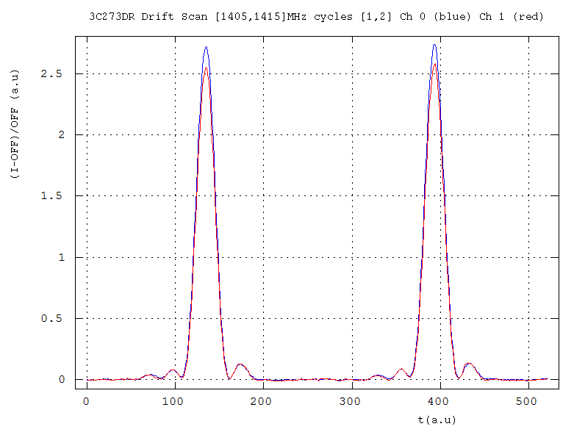
Drift Scan: time evolution
2 cycles 170sec (*)
(30% eff.)
“0FF” done with the first 30sec
Mean of the band [1405,1415]MHz

Slide 16
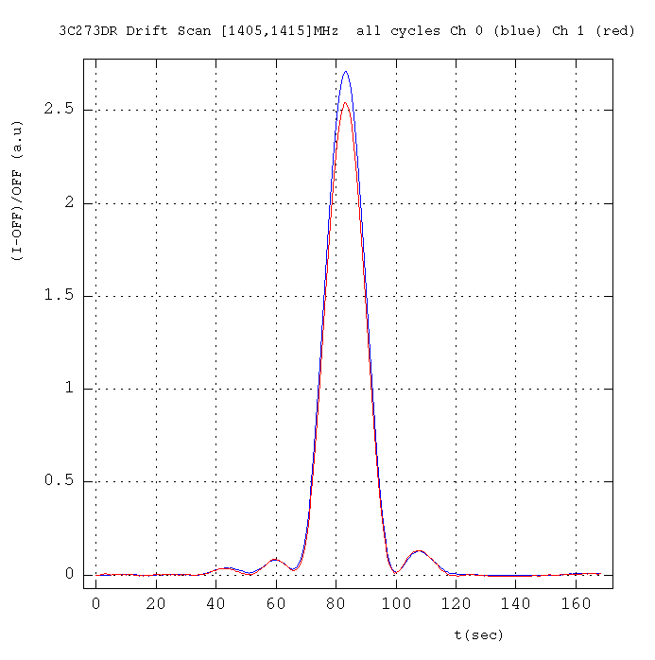
Drift Scan: time evolution

Slide 17
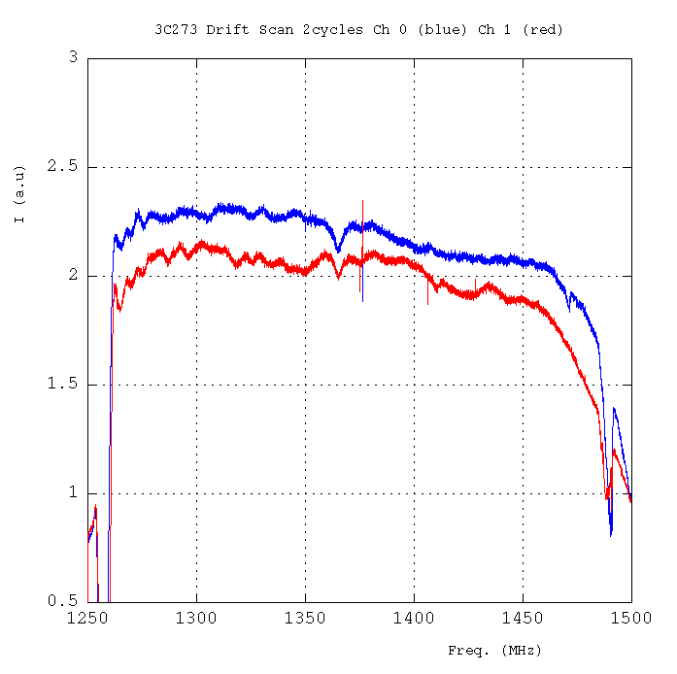
Drift Scan: Frequency
Mean over the time FWHM
(absolute value not to be compared to ON-OFF)
Same behavior as ON-OFF

Slide 18
Bridle et al., 1972: I(1400 MHz) : 38.84 (0.70) Jy - Kühr et al., 1981 & NED Freq.(MHz) Flux (Jy) -------------------------------------------------- 1400 41.28 1.23 Witzel et al. 1971 1400 46.30 2.30 Kellerman et al. 1969 1410 45.17 1.07 Wills 1975 1410 MHz 42.00 ... Jy -> Wright et al. 1990, Parkes 1400 MHz 45.0 +/- 5 % Jy -> PAULINY-TOTH et al., 1966
1400 MHz 39.62 ± 0.38 Jy -> idem
1.4 GHz (ATCA) 35.82 ... Jy -> Tingay et al., 2003, PASJ
1.40 GHz 50100 ...milliJy -> White et al., 1992, 300ft, -> Condon et al. 1985,1986
1.4GHz 54992.1 ± 1900.3 milliJy -> Condon et al. 1998, NVSS
--------------------------------------------------
3C273
Our measurement : ~2 x 2.62 au x 11.3 Jy/au ~ 59.2 Jy
3C161

Slide 19
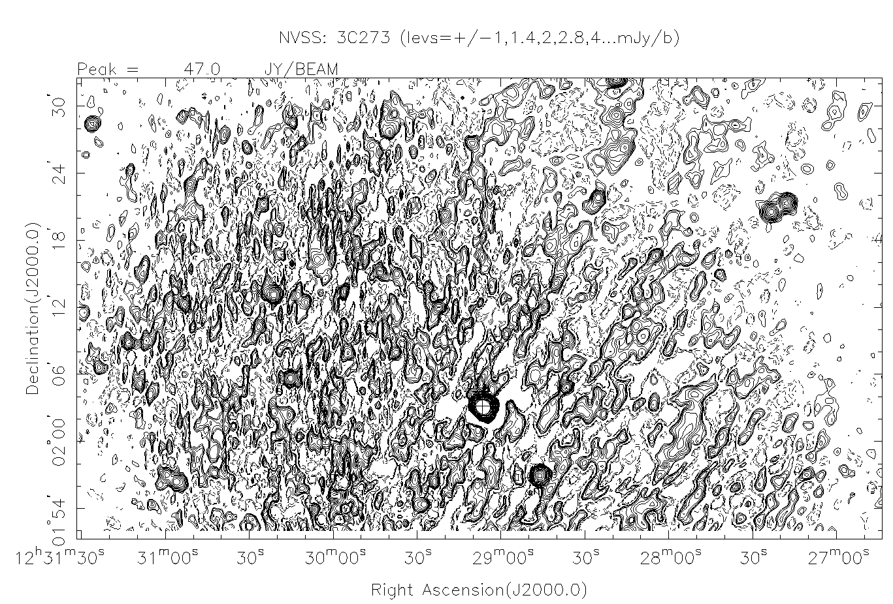

Slide 20
NGC4383 ON-OFF
SCA156855.171
Date 2011-10-22
Cycles 1-15 foreseen but 12-15 only !

Slide 21
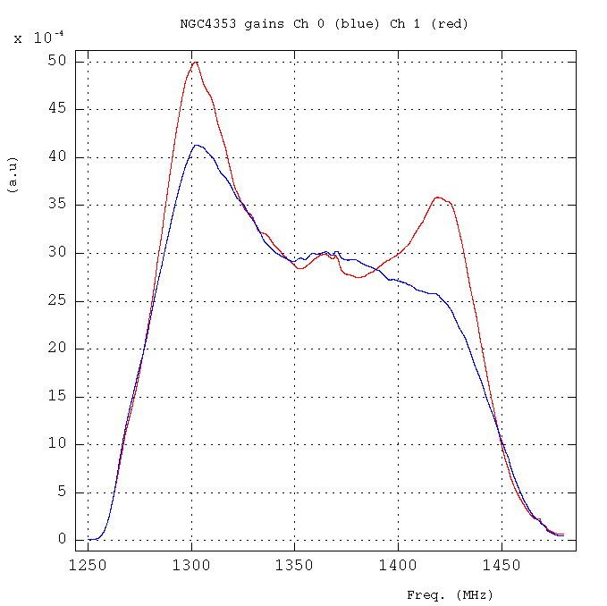
Gains cycle #13
Gains different shape as I was expecting. But confirmed by Ana that they have changed since 7th July…

Slide 22
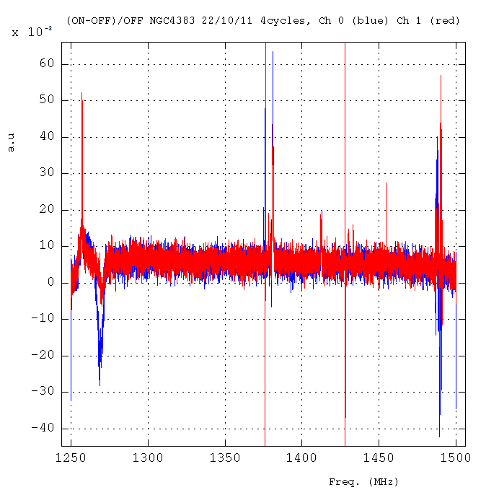
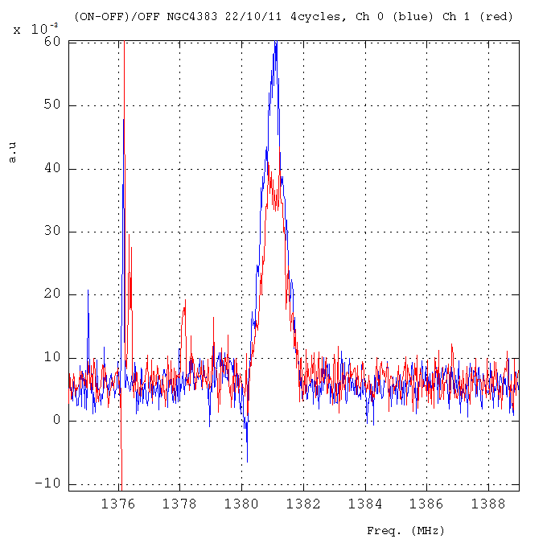
RFI
HI-line

Slide 23
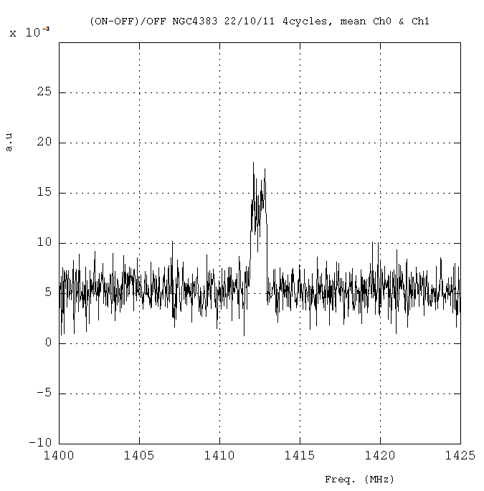
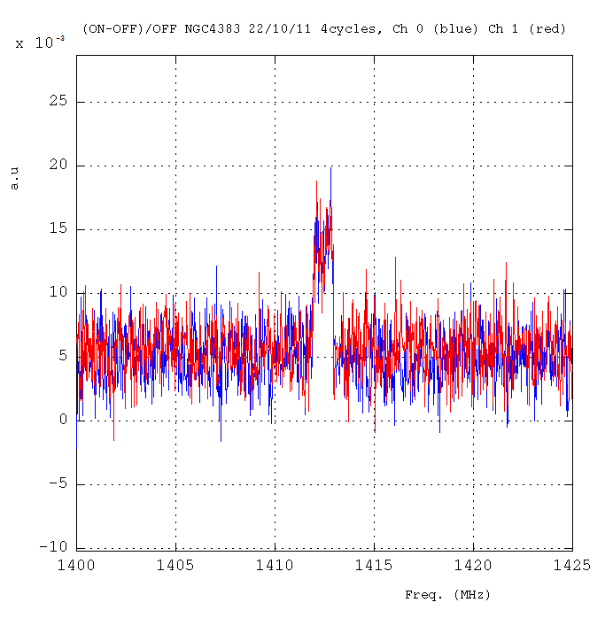
Continuum & line
Zoom of HI line
Continuum: ~ 44.3 ± 4.1 mJy
HI Line:
width ~213km/s ~1MHz
int. 48.4 ± 5.1 Jy km/s ~230mJy
A. Chung et al, VLA IMAGING OF VIRGO SPIRALS IN ATOMIC GAS (VIVA). I., The Astronomical Journal, 138:1741–1816, 2009 December
THE ATLAS AND THE Hi PROPERTIES
Mean of Ch0 & Ch 1
1MHz
Ch 0 = Ch 1
1420.20/(1+0.0057) = 1412.15 MHz = 1700 km/s OK

Slide 24
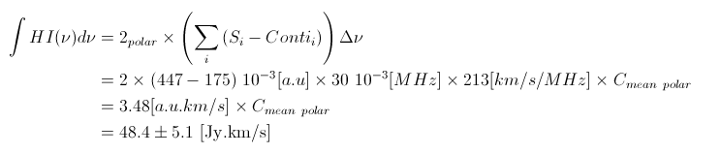

The HI line intensity
Integral in the range [1412-1413] MHz
Then
To be compared to 11.3 Jy/au
Or
3.48 x 11.3 = 39.3 [Jy.km/s]
To be compared to 48.4 Jy.km/s
3C161

Slide 25
NGC4383 Drift Scan
SCA157756.171
Date 2011-11-19
Cycles 2-15

Slide 26
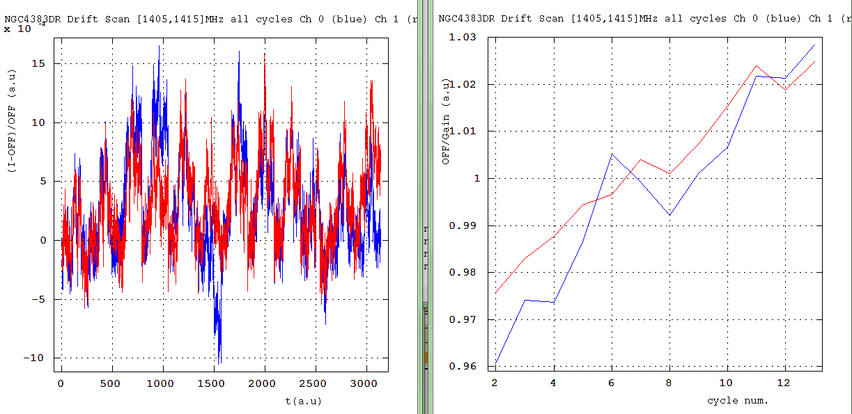
(I-OFF)/OFF
OFF/Gain
Variation ±3%

Slide 27
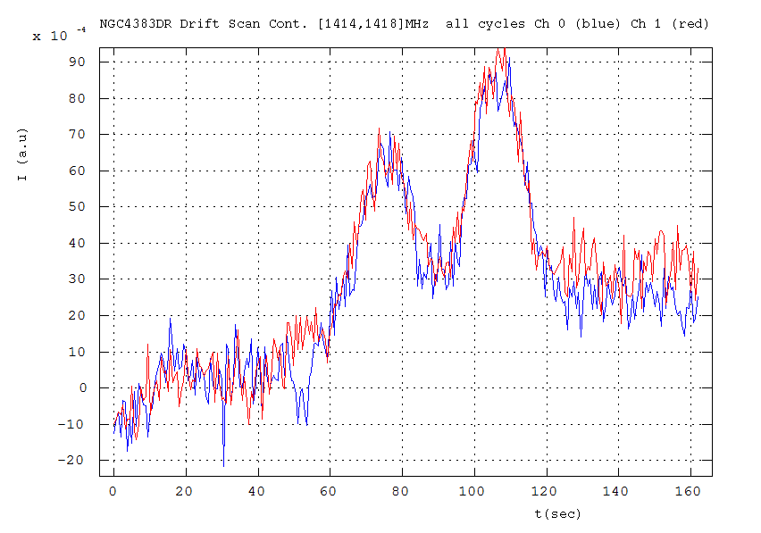
Continuum evolution

Slide 28
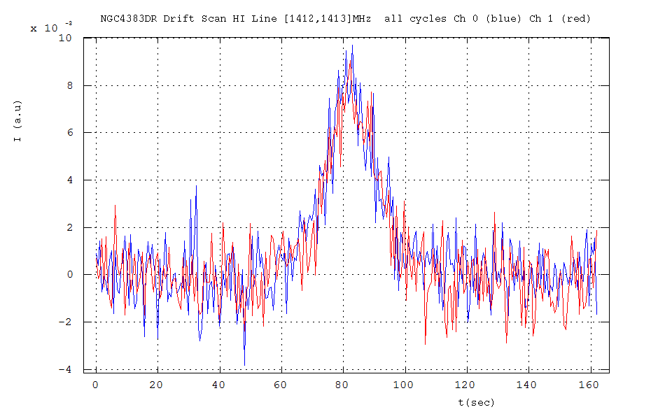
HI Line evolution
8 10⁻³
3C161
11.3Jy/au x 2 x 8 10⁻³ (au) = (181±5) mJy to be compared to (230±24m)Jy

Slide 29
Summary
3C161 @ 1410MHz gives 11.3±0.3 Jy/au
Overestimation of 3C273 continuum
Underestimation of HI NGC4383
Close to Ch 1 DAB (Est) calibrated thanks to PKS1127-14 WIBAR DAQ.
How to calibrate another freq. although the BAO spectra are quite stable in freq.

Slide 30
Abell85, 2440, 1205 zoom on HI

Slide 31
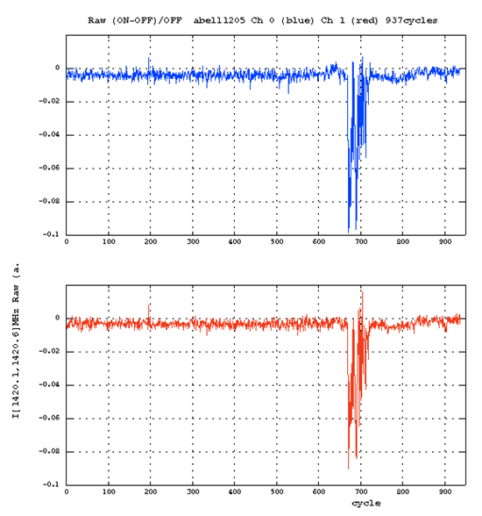
Abell 1205: DAQ stability
[1420.1,1420.6]MHz vs cycle
22/08/11-22/09/11

Slide 32
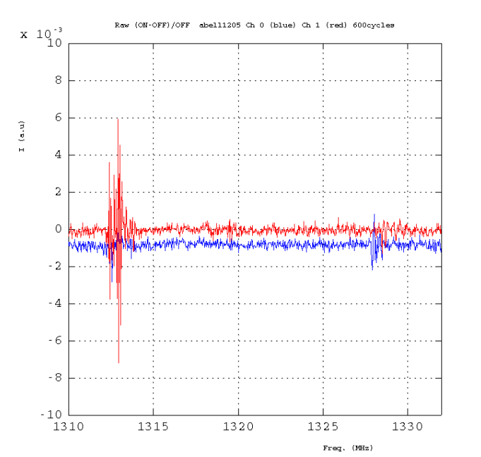
Abell1205
(ON-OFF)/OFF_f
600 cycles

Slide 33
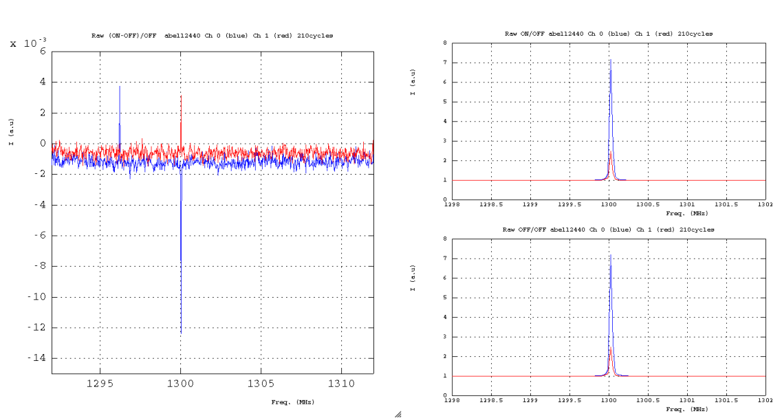
Abell2440
ON/OFF_f
(ON-OFF)/OFF_f
OFF/OFF_f
210 cycles

Slide 34
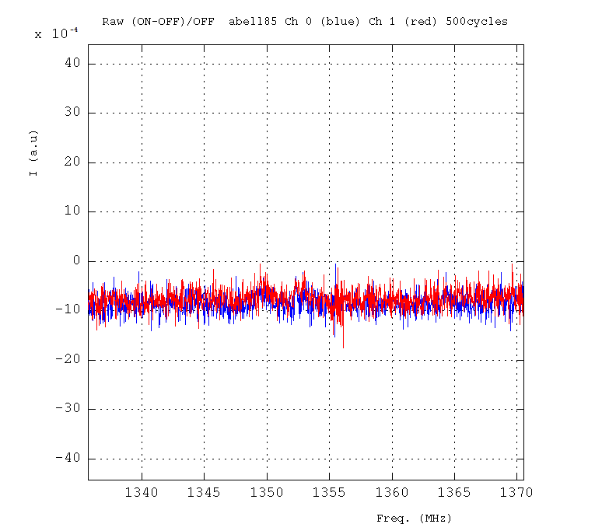
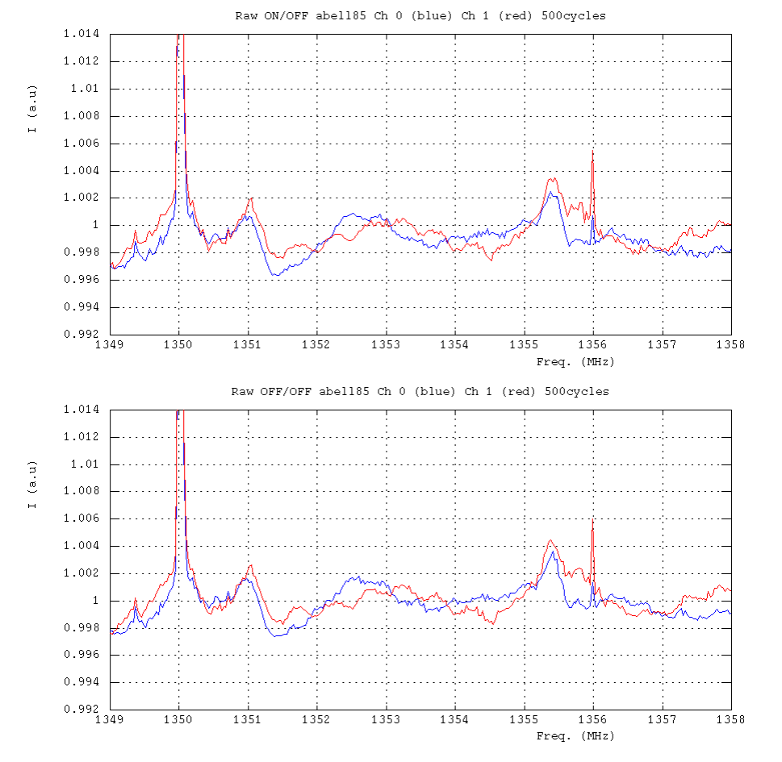
Abell85
(ON-OFF)/OFF_f
500 cycles
ON/OFF_f
OFF/OFF_f

Slide 35
Noise: introduction

Slide 36
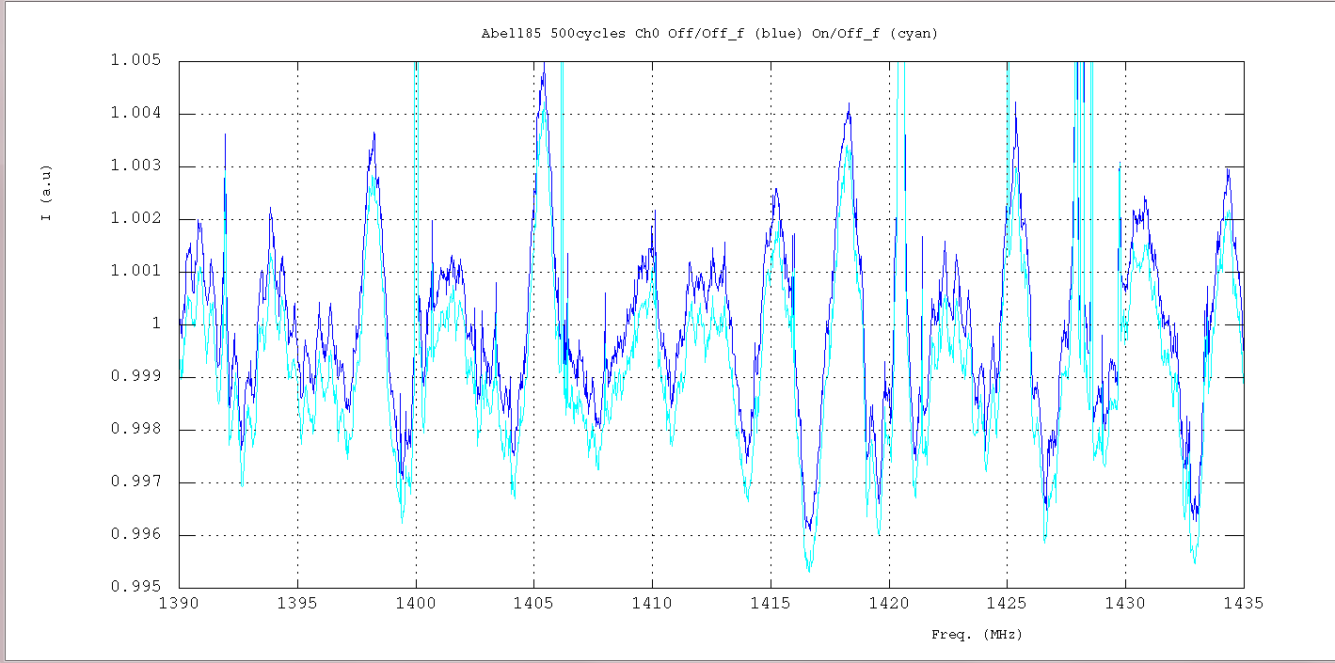
Zoom of the Abell85 normalized spectra obtained with 500cycles
Ch. 0 (On & Off)/Off_filtered
2 “oscillations” : ~2.5MHz (large amp.) & ~500kHz (small amp.)

Slide 37
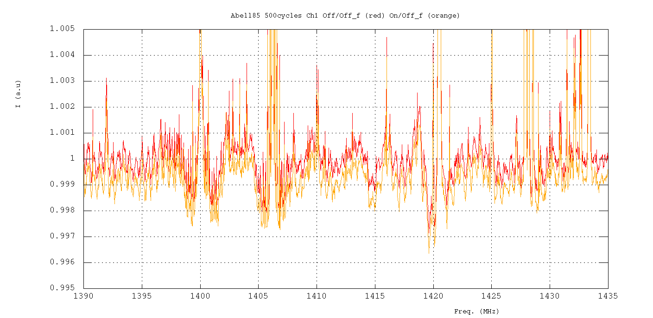
Ch. 1 (On & Off)/Off_filtered
Only 1 “oscillation” : ~500kHz (small amp.)

Slide 38
Some facts
The large oscillations are visible with only few data taking < 1min.
The small ones need summation so normalized spectra are the gain change…
The noises are present on all data: Abell, 3C, NGC.
The 500kHz noise was in fact present since Juil. 2010 in the UGC4358 on non normalized spectra for both channels.

Slide 39
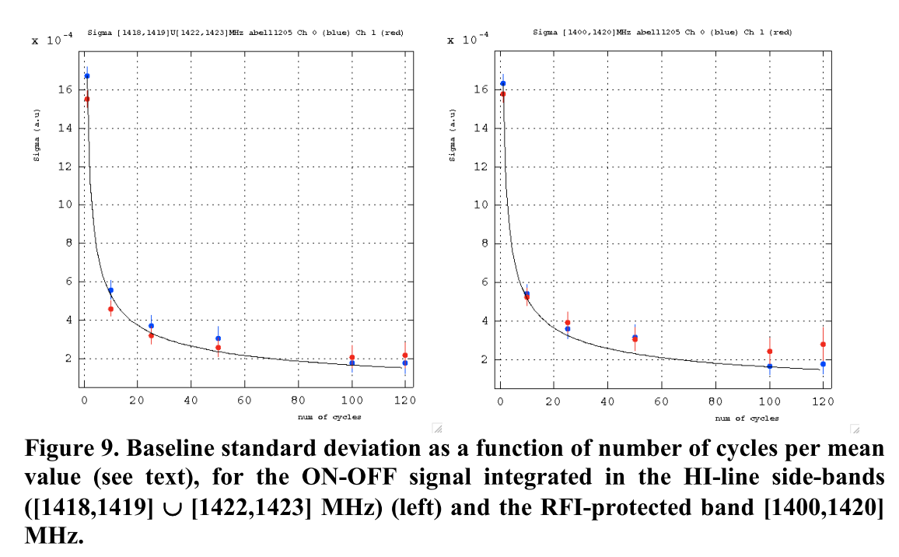
σ
Δf = 4MHz
Δf = 20MHz
One would have expected 1/√5 improvement!!!
Extracted from Abell1205 MEMO 23/11/11

Slide 40
Data processing on Irods @ CCIN2P3
Median ov. 5120 BAO paq. ON/Gain or OFF/Gain
Mean of 5 medians => med. spectrum (FITS files)
Mean on each cycle
For each cycle (ON-OFF)/OFF_f
Result of (ON/G-OFF/G)/(OFF/G)_f
G=Gain med. Filtered 3MHz
(OFF/G)_f= (OFF/Gain) med. Filtered 2MHz
For each cycle too < (ON-OFF)/OFF_f > ov. [ν_{1,} ν₂]

Slide 41
Sigma
Estimation
<ON/Gain>(ν) ~ <OFF/Gain>(ν) ~ 1 (no signal & def.)
σ[OFF/OFF_f]  σ[ON/OFF_f] (at leats it is a fact)
σ_{med} =med/(ln2 √N_{paq}) and med[ON/Gain] ~ med[OFF/Gain] ~1
(a.u)
1 cycle
5
~9
5120
σ (1cycle) ∝ 1/√Δf and σ(n cycles) ∝ σ(1)/√n

Slide 42
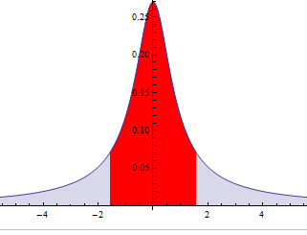
Evolution of sigma computation
The sigma may be affected by the noise (see Ana’s talk)
To avoid artifact we use now the inter quartile range IQR normalized
25%
25%
IQR for Normal dist. with σ=1

