Slide 1
Calibrator Sources
3C273, 3C261
JE Campagne
16/1/2012

Slide 2
3C273 – 2011/12/09
ON/OFF & Drift

Slide 3
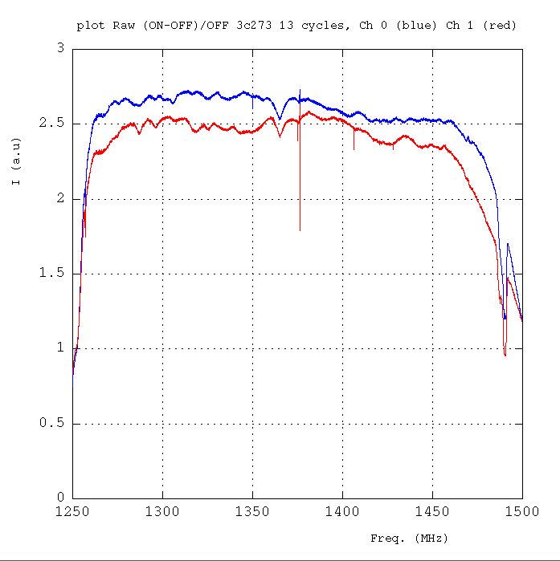
(ON-OFF)/OFF-flitered
13 cycles 30sec
each (30% eff.)

Slide 4
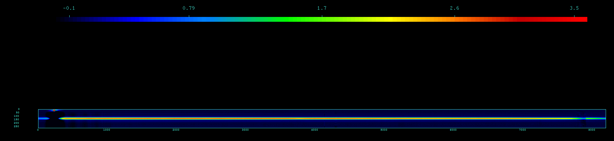
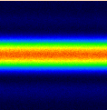
Drift Scan: I(time, frequancy)

Slide 5
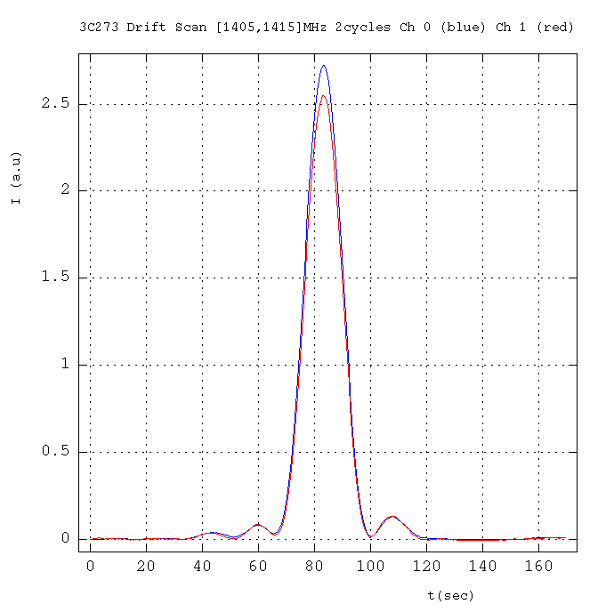
Drift Scan: time evolution
2 cycles 170sec (*)
(30% eff.)
“0” done with the first 30sec
Mean of the band [1405,1415]MHz

Slide 6
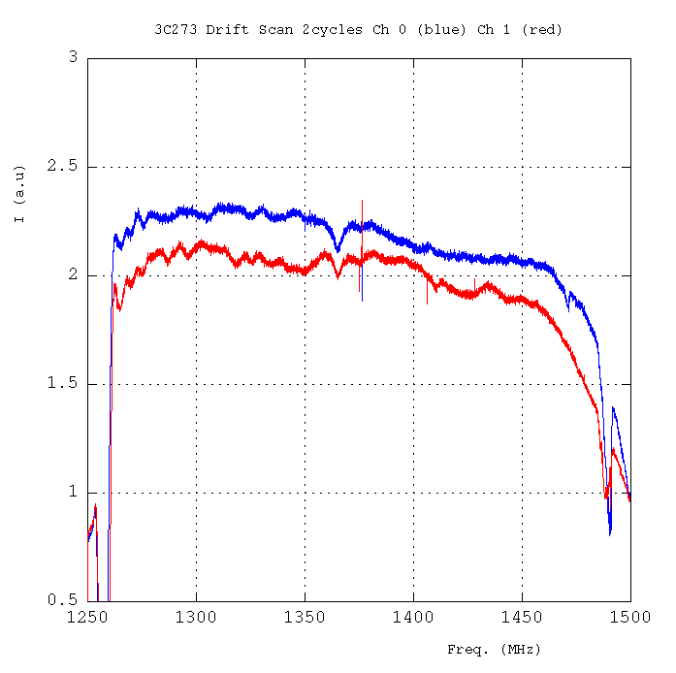
Drift Scan: Frequency
Mean over the time FWHM
(absolute value not to be compared to ON-OFF)
Same behavior as ON-OFF

Slide 7
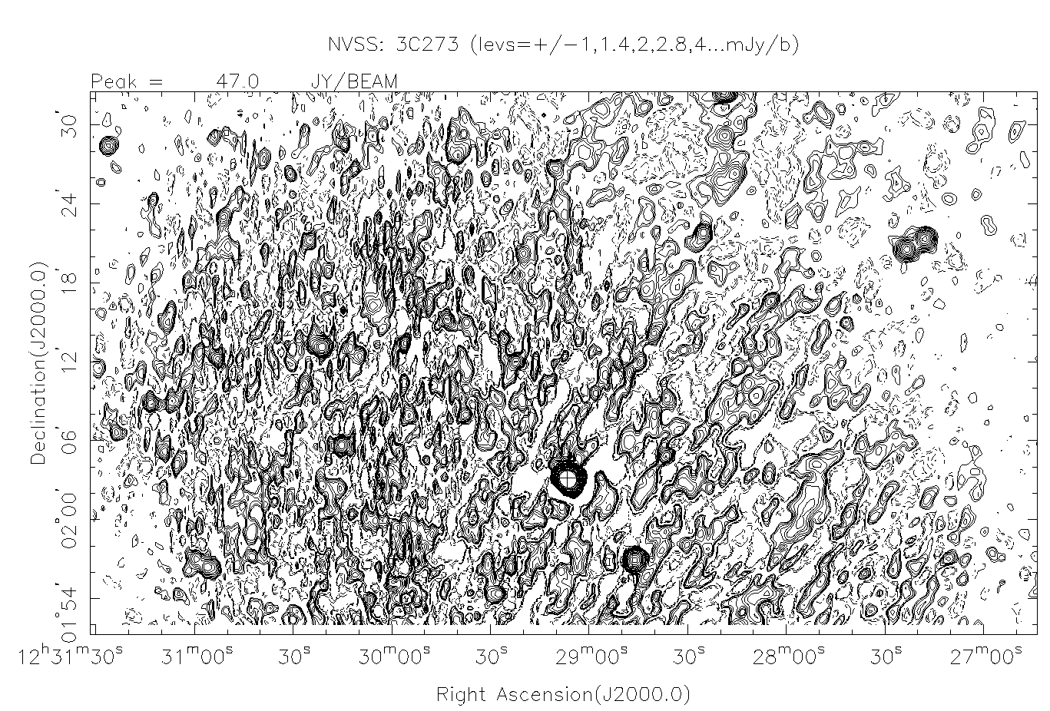

Slide 8
3C161 Drift Scan

Slide 9
Data
2 runs 2011-12-09
  3C161 : 0:57:21 start
    3 cycles/4 available 2-4
  3C161B : 1:11:50
    7 cycles/9 available 3-9
1 cycle = 170 sec ON-like
Add the images time-freq. and use the first 30sec as “0”
No use of DAB

Slide 10
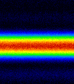
Image time-Freq.

Slide 11
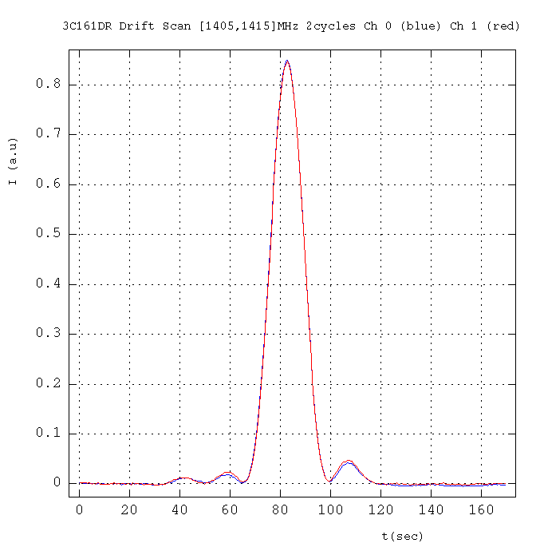
Time evolution
Timing: 8.22kHz

Slide 12
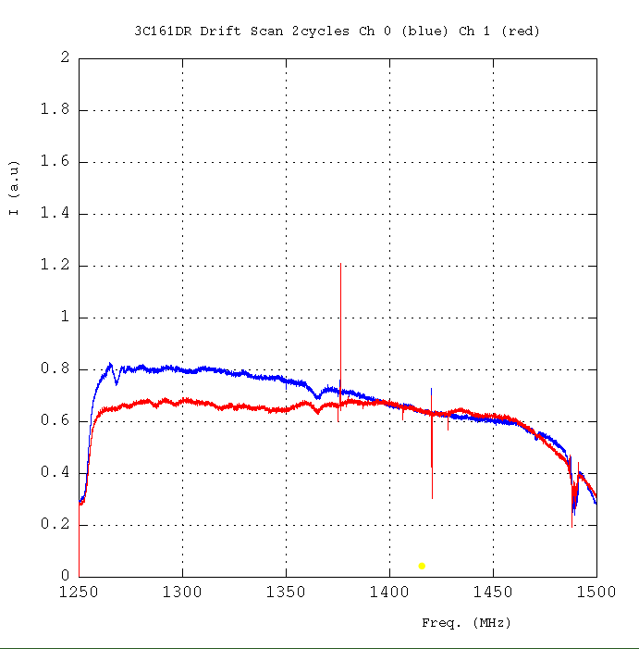
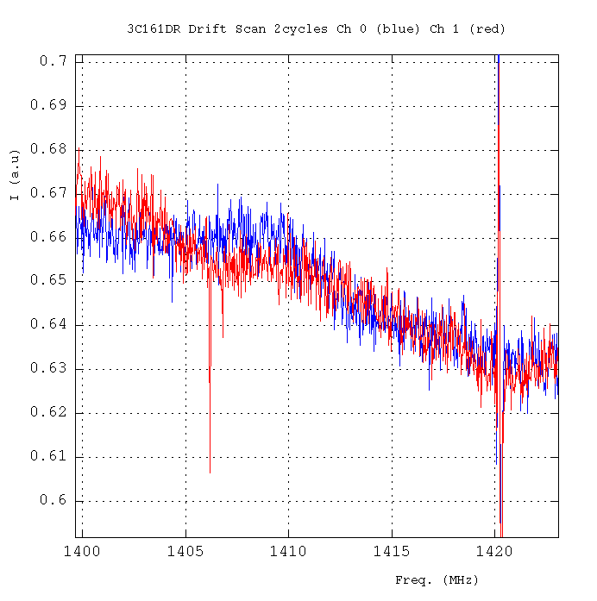
Spectra integrated during the FWHM of the drift.
Differences wrt the 3C273 spectra
Polarization?

Slide 13
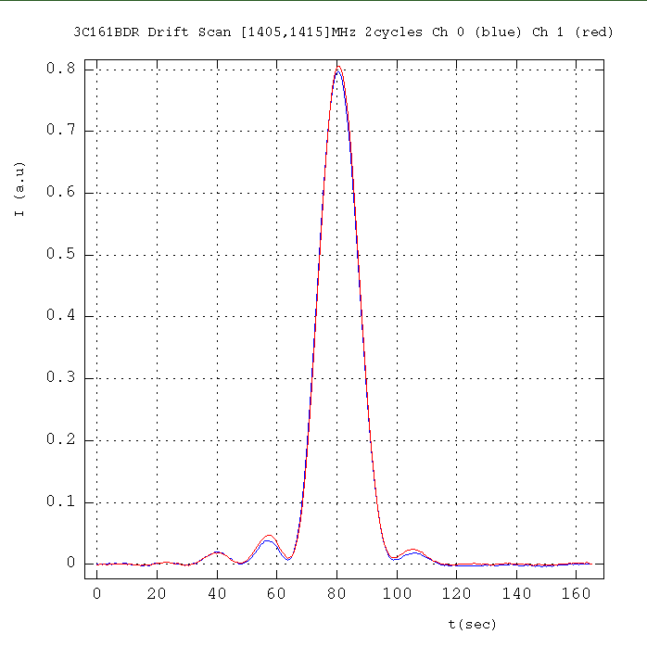
The 2 drifts of 3C161
±3% effect on peak value
3 cycles
7 cycles
The freq. spectrum remains the same

Slide 14
Calibration: 1polar for I_{tot}
3C161 0624-05 (Baars et al 1977)
----------------------------------------------
Freq MHz 1250 1280 1380 1410
Flux Jy 20,636 20,294 19,233 18,937
----------------------------------------------
1410MHz
23.2 Jy/a.u
Ott et al. , 1994
3C161
Freq. Flux date Obs.
MHz Jy
-------------------------------------
1408 18.58 (0.09) Feb. 1990

Slide 15
Bridle et al., 1972: I(1400 MHz) : 38.84 (0.70) Jy
- Kühr et al., 1981 & NED
Freq.(MHz) Flux (Jy)
--------------------------------------------------
1400 41.28 1.23 Witzel et al. 1971
1400 46.30 2.30 Kellerman et al. 1969
1410 45.17 1.07 Wills 1975
1410 MHz 42.00 ... Jy -> Wright et al. 1990, Parkes
1400 MHz 45.0 +/- 5 % Jy -> PAULINY-TOTH et al., 1966
1400 MHz 39.62 ± 0.38 Jy -> idem
1.4 GHz (ATCA) 35.82 ... Jy -> Tingay et al., 2003, PASJ
1.40 GHz 50100 ...milliJy -> White et al., 1992, 300ft, -> Condon et al. 1985,1986
1.4GHz 54992.1 ± 1900.3 milliJy -> Condon et al. 1998, NVSS
--------------------------------------------------
3C273
Our measurement : ~2.5 au x 23.2 Jy/au ~ 58 Jy

