Slide 1
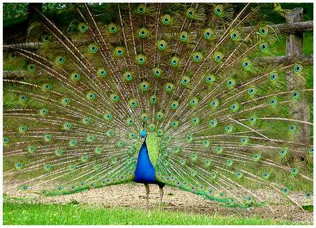
PAON project
J.E Campagne
LAL
17/5/2012
PAON: Paraboles A l’Observatoire de Nançay

Slide 2
Organisation
Scientific Concil: R.Ansari (LAL), Ch. Magneville (CEA/Irfu), J.M.Martin (Obs. Paris/Meudon)
  + 6 other members
2 co-PI: J.E Campagne (LAL) & J.M.M
2 Project Ingeeniers:
  D. Charlet (LAL): Electronics & software
  F. Rigaud (Obs. Paris/Meudon): Mechanics & Nancay implantation

Slide 3
Why Nançay (reminder)
150 ha of free field dedicated since the 50’ to radioastronomy
Close to Orsay ~ 2h drive dist.
Existing local infrastructure
Protected bandwidth [1400-1427]Mhz
Since 2008: BAORadio electronics at the focal plane of the NRT with 2 programs:
  Focal Array @ Nançay (FAN)
  HI-Cluster @ Nançay

Slide 4
Budget from recent Scientific Committee @ Obs. Paris & LAL
LAL: 23k€
  Dishes, mounts, System control, DAQ PCs, cables
Obs. Paris/Meudon: 13k€
  Feed, dish-feed adaptation & Nançay infra.
CEA/Irfu: few k€
  LNA
~40k€

Slide 5
PAON phases
PAON-2 (2012): validation phase
  2 Dishes ∅ 3m (RF Hamdesign)
  Elevation only manual
  Dedicated feed 1250-1500 MHz with LNA homemade
  Existing BAORadio electronics: 2 polarizations/dish
PAON-4 (2013): observation phase
  4 dishes in remote control
Goals: Beam, Noise, Cross-talk, Transit observation of fringes

Slide 6
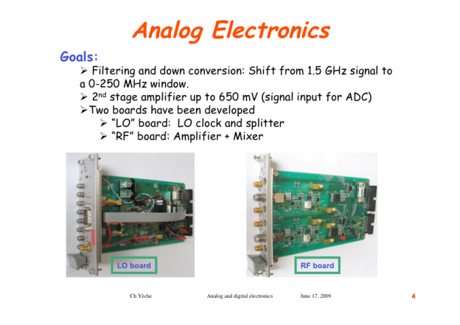
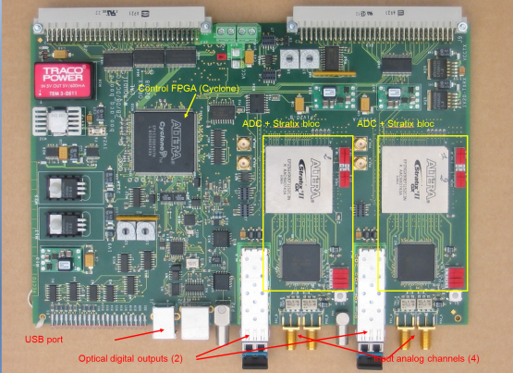
BAOradio existing chain (32 channels)
AEM : Analog Electronic Module ( Amplification, filtering, frequency shifter)
DCLK : Clock and trigger distribution system
DFS : Digitizer Frequency Separator (ADC-Board) 4 channel, 500 MHz sampling, with on the fly FFT capability, dual high speed optical data transfer
PDR : PCI-Express data reception module

Slide 7
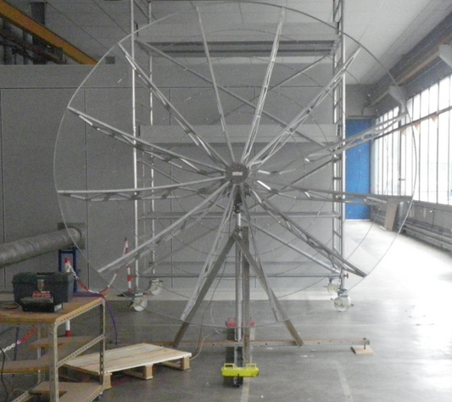
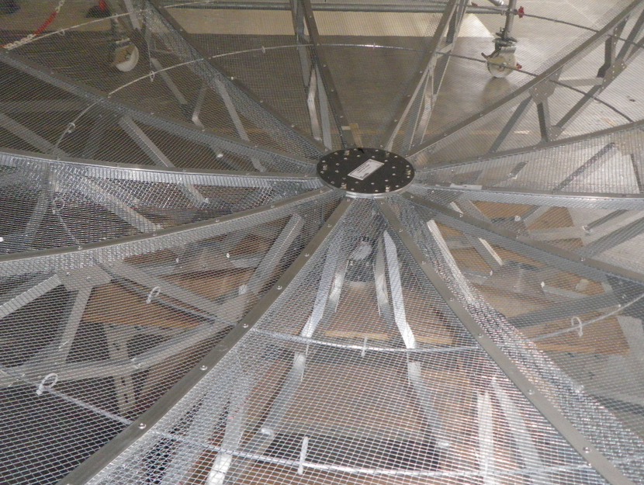
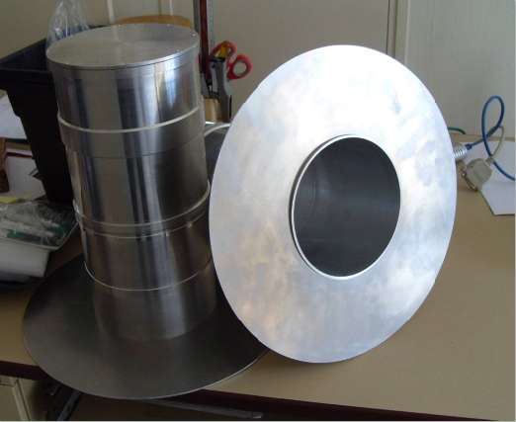
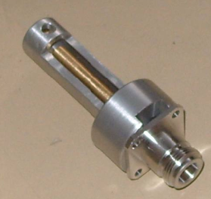
Some recent realizations…
RF-HAMDesign
Meudon/Nançay
X2/feed

Slide 8
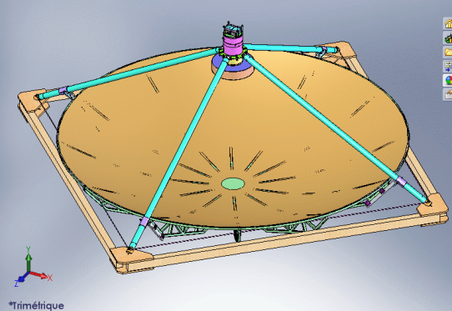
Fiber glass bars
Frame for feed position commissioning
Meudon

Slide 9
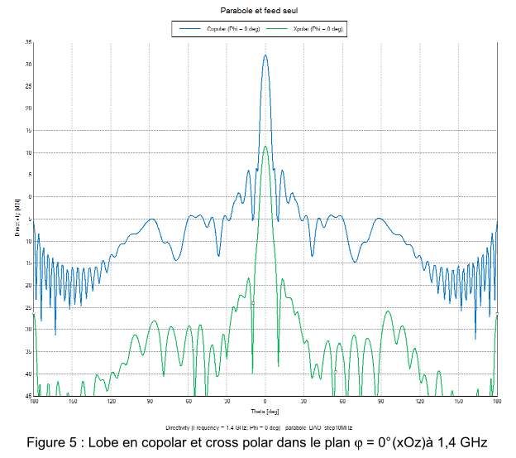
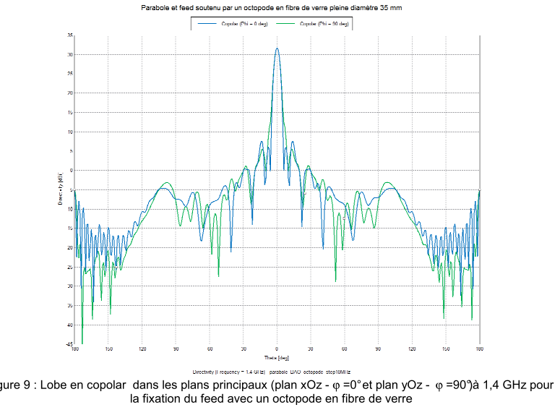
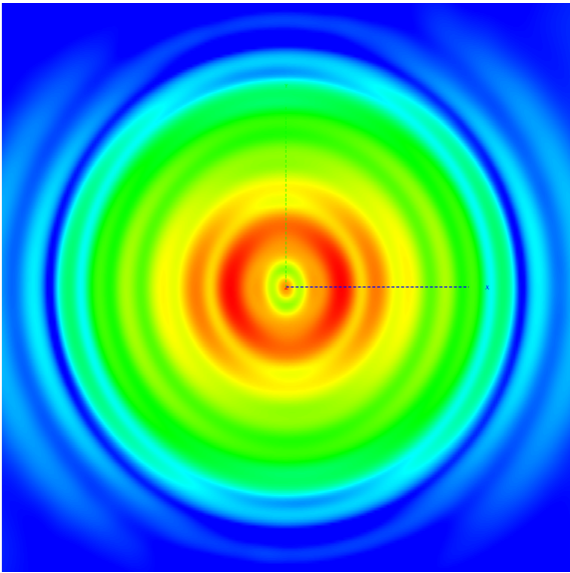
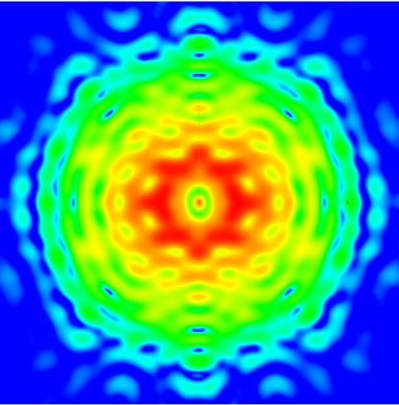
Feed & dish simul.
Dish+Feed only
8 Glass fiber bars
Nançay

Slide 10
Site considerations
Electromagnetic compatibility is a real matter of concern:
  The present basic mount is not useable for debugging phase (too noisy) => manual elevation positioning is foreseen (Ok)
  The DAQ electronics should be shielded too:
    PAON ask recently to be housed in the EMBRACE special container
PAON location is under discussion

Slide 11
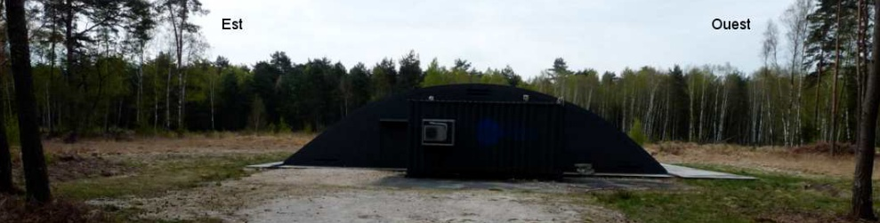
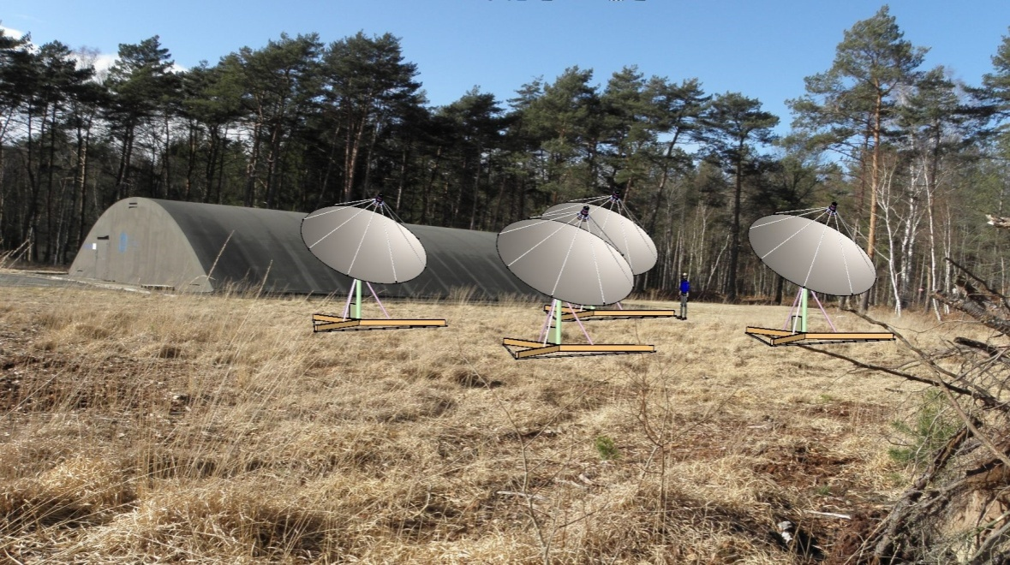
PAON location near EMBRACE
The special container
Design F. Rigaud (Meudon)

Slide 12
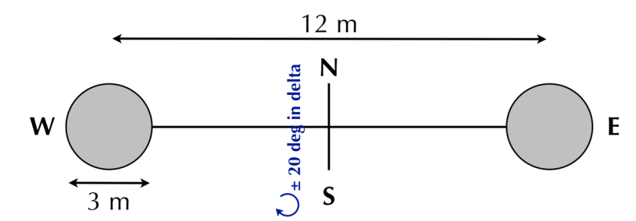
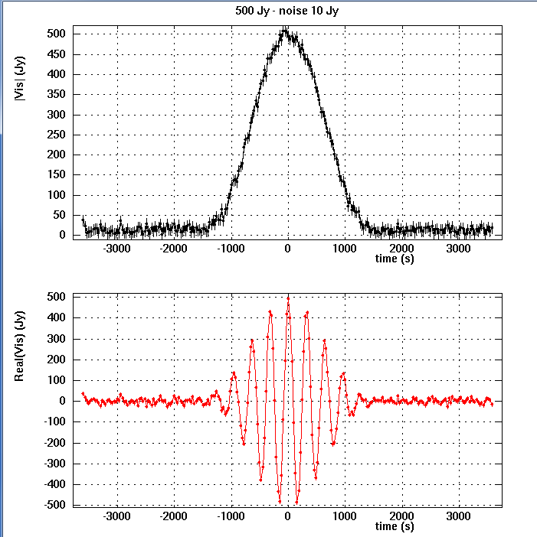
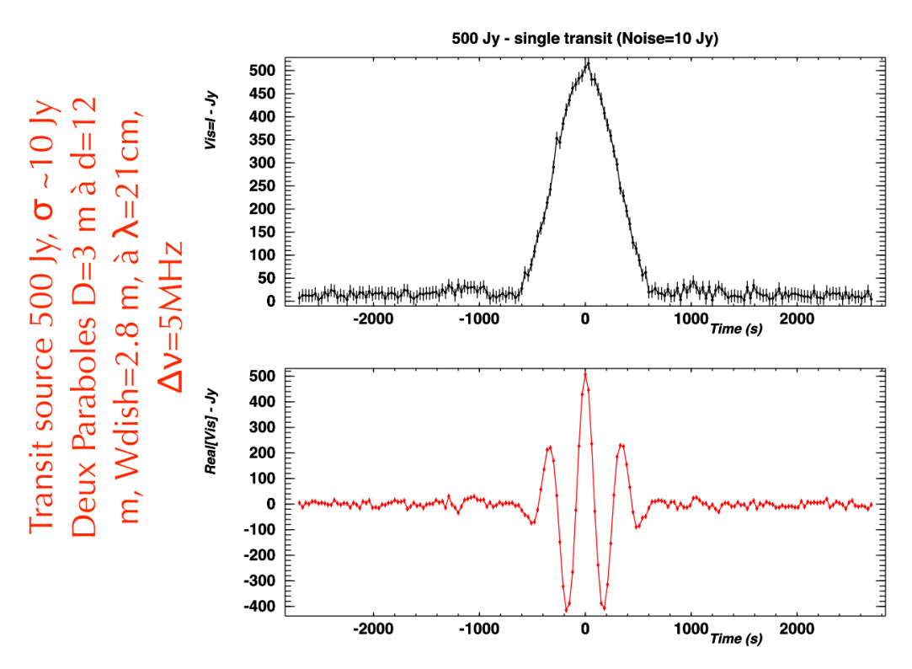
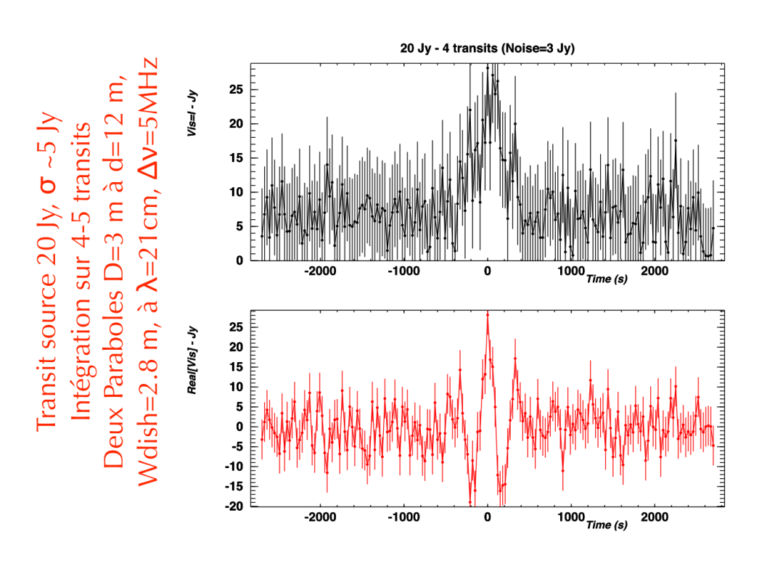
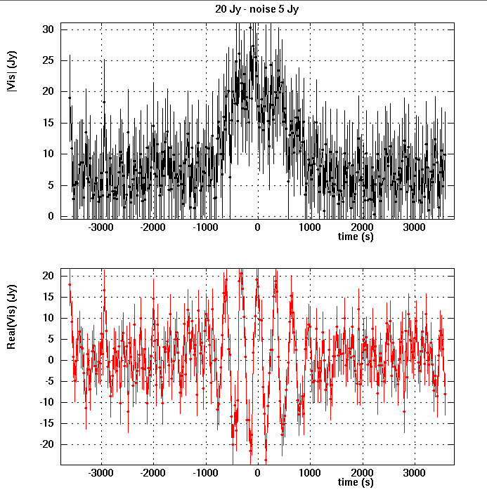
Test of transit observation PAON-2

Slide 13
PAON-2 to PAON-4
What was foreseen : Use 4 dishes 5m ∅
    in project @ RF-HAMdesign since Jan. 2011 4.5m in light material. But they have resigned April 2012 due to market considerations: ie. they have a lot of demands for <=3m and very few for >3m dishes
    Other manufacturers can provide larger dishes but either with poor mechanical characteristics either with very heavy dishes (>300kg) although well machined (eg. ComStar)
    Investigation for home made dishes in Meudon
In standby for the moment

Slide 14
PAON-2 to PAON-4
Alternative: Use 6 dishes 3m ∅
  This is manageable but only ~40m²
  (compared to 70m² with four 5m-dishes)
Objective: perform long term observation (several months) to show the stability of the whole BAORadio system:
    Fringes seen at Pittsburg up to 32-channels during small data taking
    Long term stability shown with single channel during the HI-cluster program at Nançay

Slide 15
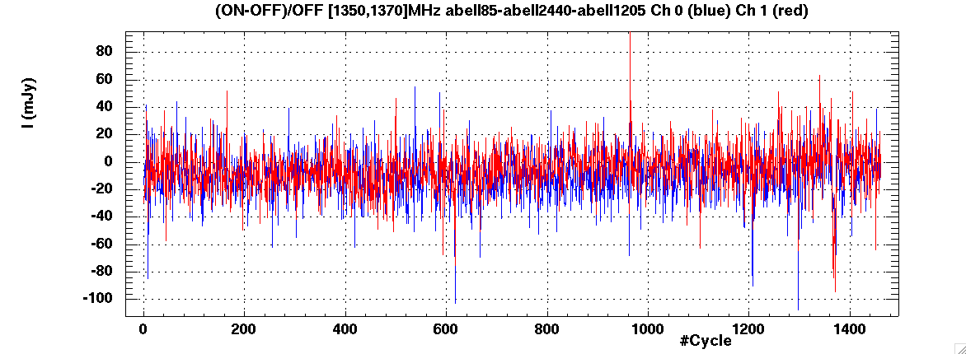
HI-Clusters stability
6 months of data taking (4h On source, eff. 30% DAQ)
Although we have identified many RFIs and 2 spectra modulations.

