Slide 1
Calibrator Sources
3C273, 3C261, NGC4383
JE Campagne
16/1/2012

Slide 2
3C161 Drift Scan
158451.171 & 158452.171

Slide 3
Data
2 runs 2011-12-09
  3C161 : 0:57:21 start
    3 cycles/4 available 2-4
  3C161B : 1:11:50
    7 cycles/9 available 3-9
1 cycle = 170 sec ON-like
Add the images time-freq. and use the first 30sec as “0”
No use of DAB

Slide 4
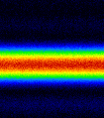
Image time-Freq.

Slide 5
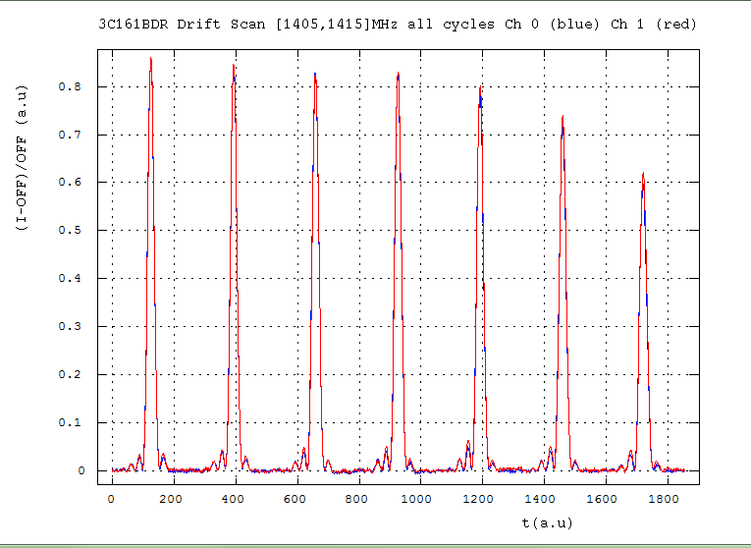
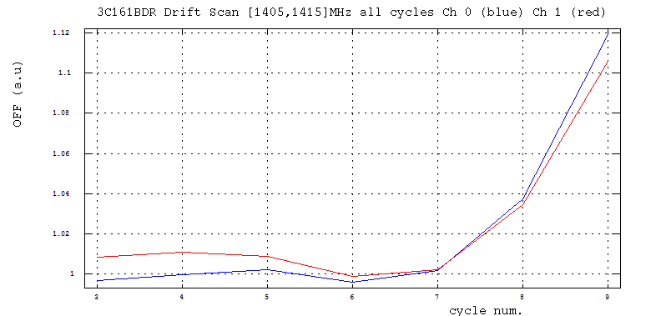
Peak int. & Tsys variations: 3C161B
−25%
3
4
5
6
7
8
9
+10%
Tsys/Gain (au)
[1405,1415]MHz
+2%

Slide 6
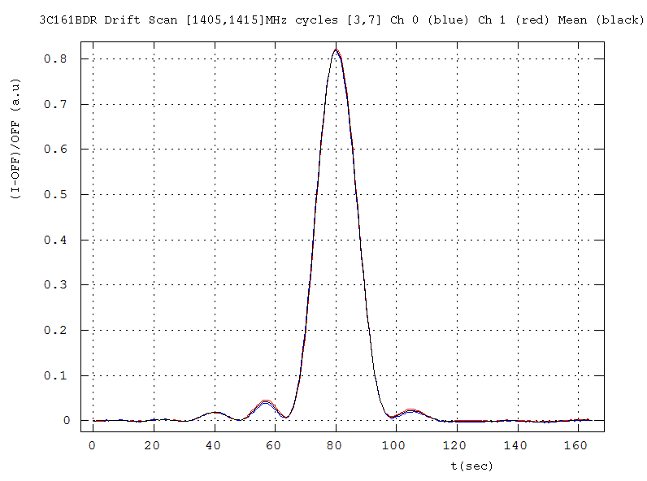
I_{peak} ~ 2x0.82 a.u
Timing: 8.22kHz

Slide 7
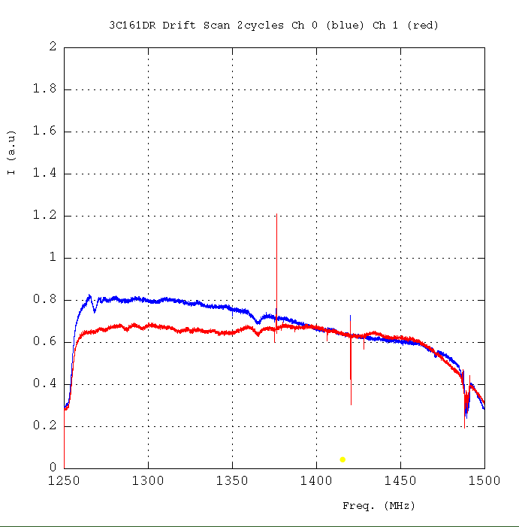
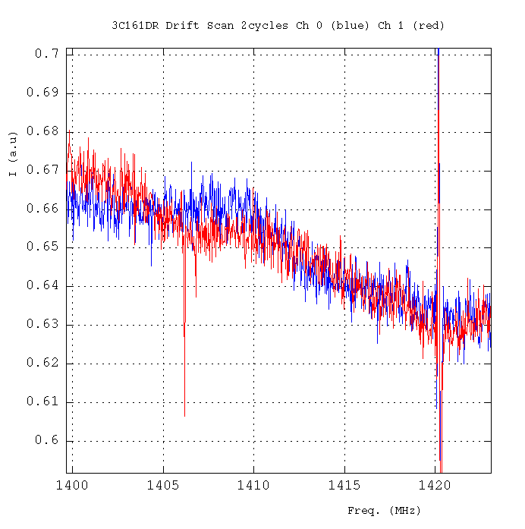
Spectra integrated during the FWHM of the drift.
Differences wrt the 3C273 spectra
Polarization?

Slide 8

Calibration
3C161 0624-05 (Baars et al 1977)
----------------------------------------------
Freq MHz 1250 1280 1380 1410
Flux Jy 20,636 20,294 19,233 18,937
----------------------------------------------
1410MHz
2 x 0.819 x C = 18.58
11.3 ± 0.3 Jy/a.u (*)
Ott et al. , 1994
3C161
Freq. Flux date Obs.
MHz Jy
-------------------------------------
1408 18.58 (0.09) Feb. 1990
3% from litt. Meas.
(*): be careful this is to be applied to the SUM of the 2 polarizations, not the MEAN

Slide 9
3C273 – 2011/12/09
ON/OFF & Drift
158461.171 & 158462.171

Slide 10
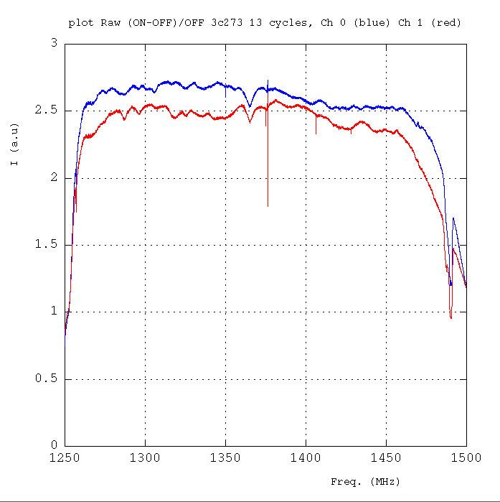
(ON-OFF)/OFF-flitered
13 cycles 30sec
each (30% eff.)

Slide 11
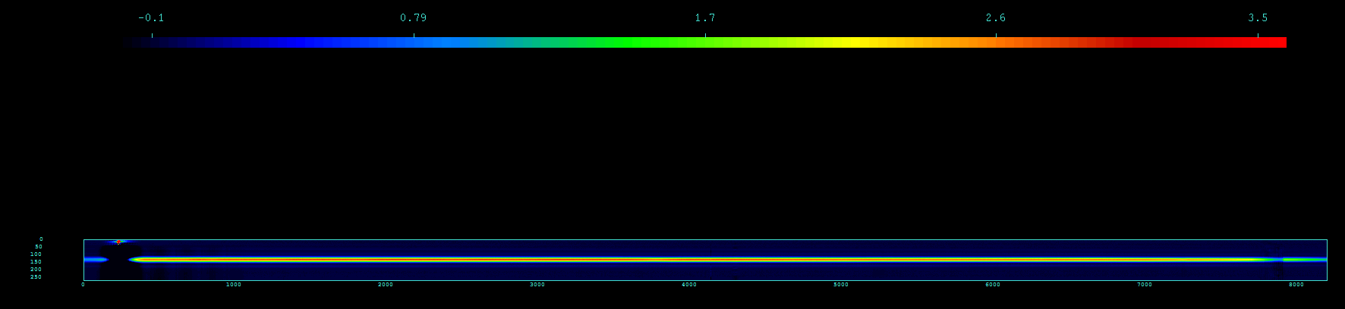
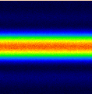
Drift Scan: I(time, frequancy)

Slide 12
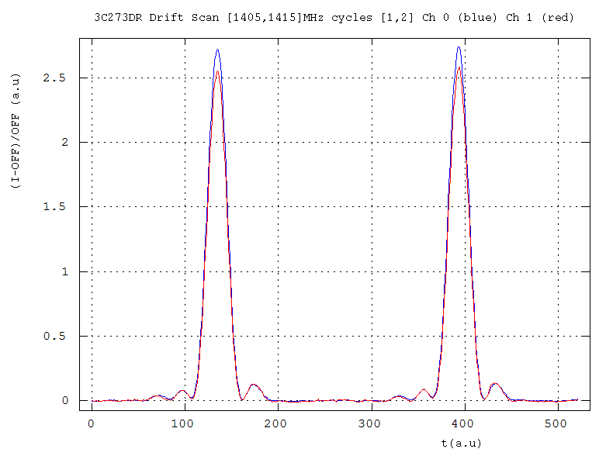
Drift Scan: time evolution
2 cycles 170sec (*)
(30% eff.)
“0FF” done with the first 30sec
Mean of the band [1405,1415]MHz

Slide 13
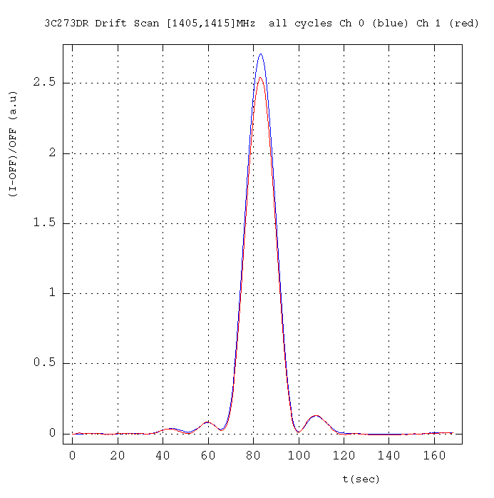
Drift Scan: time evolution

Slide 14
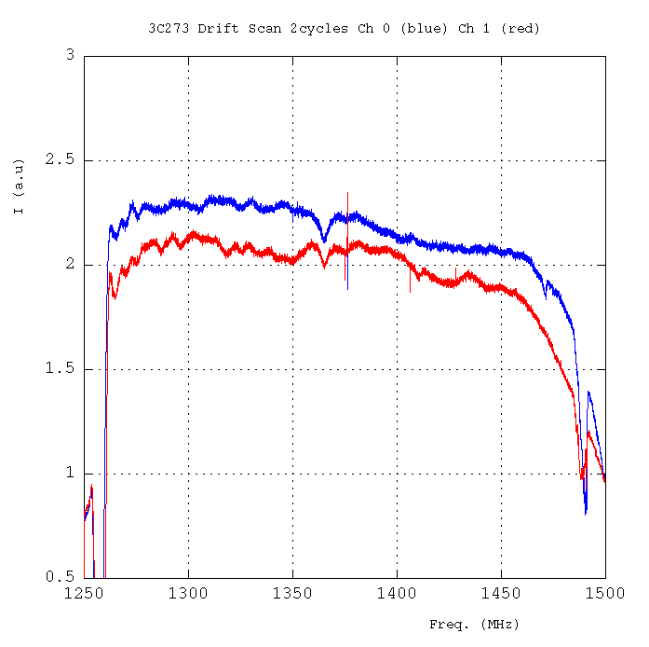
Drift Scan: Frequency
Mean over the time FWHM
(absolute value not to be compared to ON-OFF)
Same behavior as ON-OFF

Slide 15
Bridle et al., 1972: I(1400 MHz) : 38.84 (0.70) Jy
- Kühr et al., 1981 & NED
Freq.(MHz) Flux (Jy)
--------------------------------------------------
1400 41.28 1.23 Witzel et al. 1971
1400 46.30 2.30 Kellerman et al. 1969
1410 45.17 1.07 Wills 1975
1410 MHz 42.00 ... Jy -> Wright et al. 1990, Parkes
1400 MHz 45.0 +/- 5 % Jy -> PAULINY-TOTH et al., 1966
1400 MHz 39.62 ± 0.38 Jy -> idem
1.4 GHz (ATCA) 35.82 ... Jy -> Tingay et al., 2003, PASJ
1.40 GHz 50100 ...milliJy -> White et al., 1992, 300ft, -> Condon et al. 1985,1986
1.4GHz 54992.1 ± 1900.3 milliJy -> Condon et al. 1998, NVSS
--------------------------------------------------
3C273
Our measurement : ~2 x 2.62 au x 11.3 Jy/au ~ 59.2 Jy
3C161

Slide 16
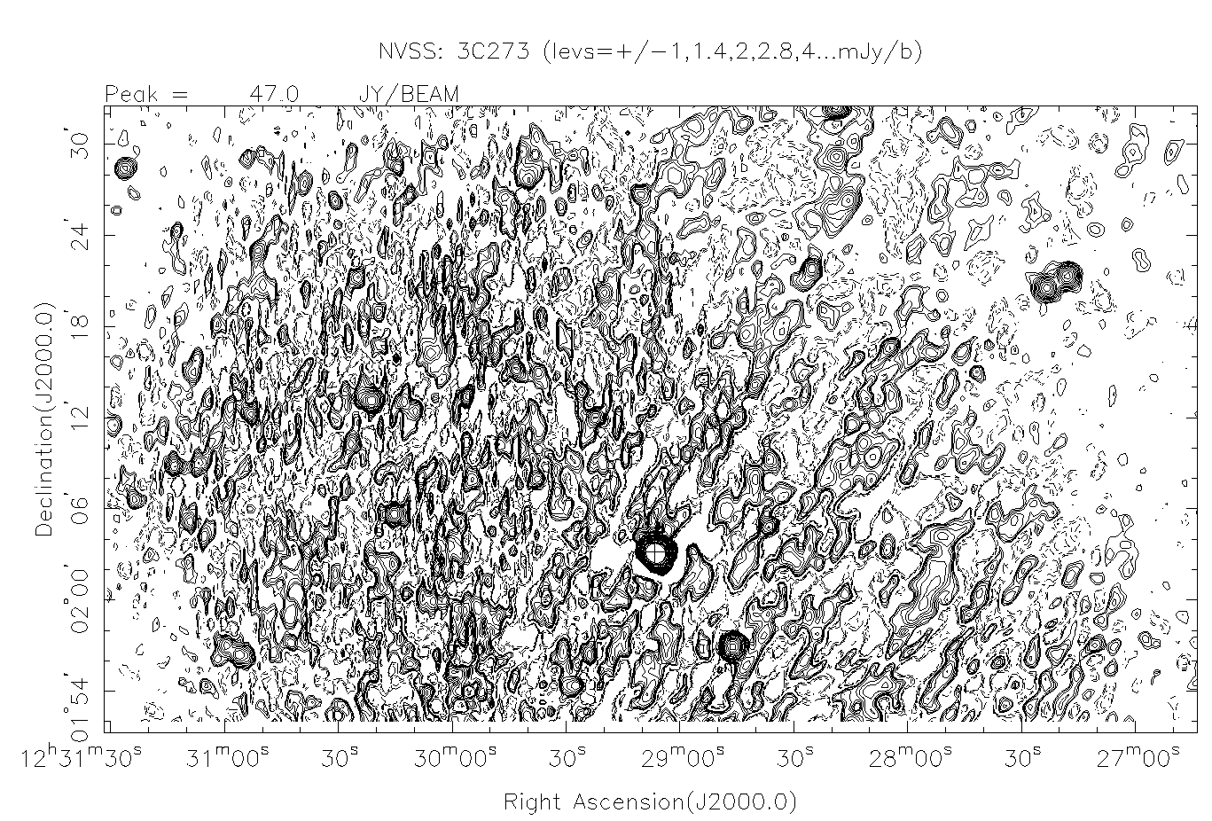

Slide 17
NGC4383 ON-OFF
SCA156855.171
Date 2011-10-22
Cycles 1-15 foreseen but 12-15 only !

Slide 18
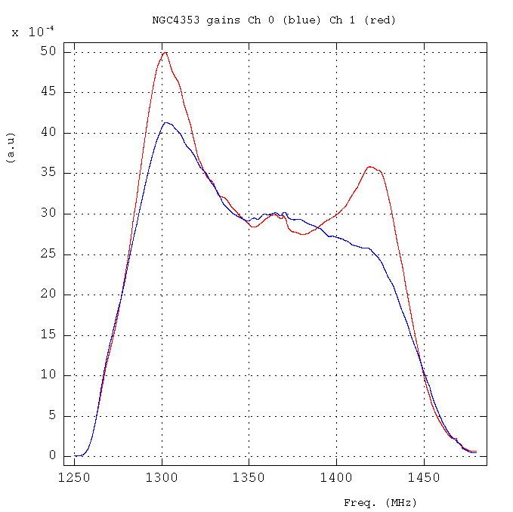
Gains cycle #13
Gains different shape as I was expecting. But confirmed by Ana that they have changed since 7th July…

Slide 19
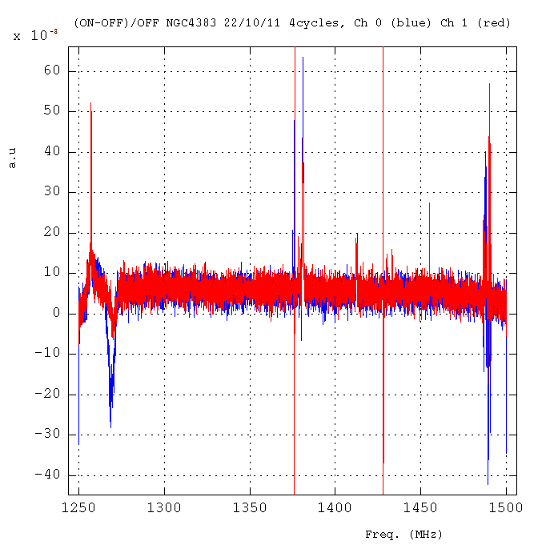
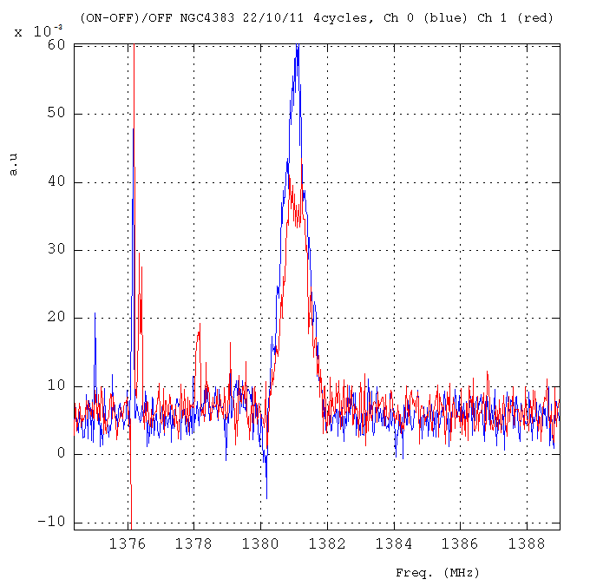
RFI
HI-line

Slide 20
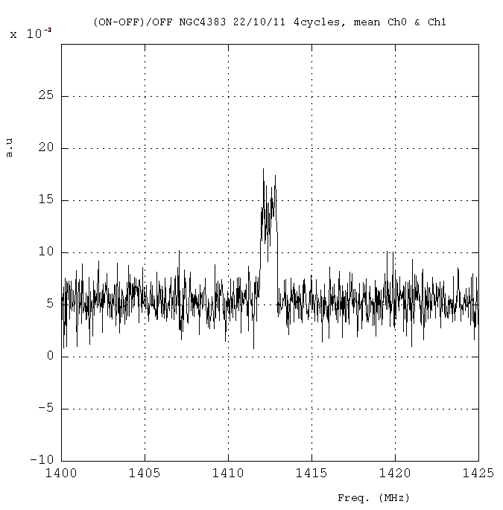
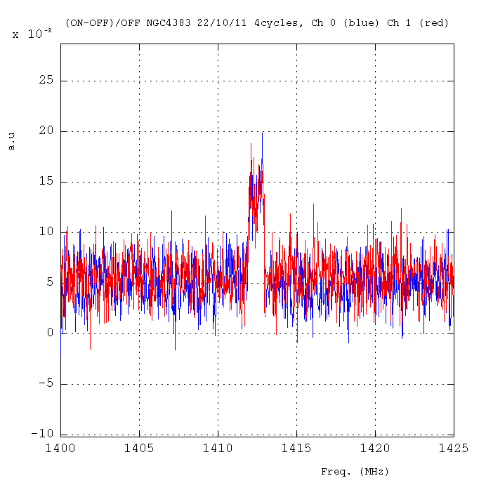
Continuum & line
Zoom of HI line
Continuum: ~ 44.3 ± 4.1 mJy
HI Line:
width ~213km/s ~1MHz
int. 48.4 ± 5.1 Jy km/s ~230mJy
A. Chung et al, VLA IMAGING OF VIRGO SPIRALS IN ATOMIC GAS (VIVA). I., The Astronomical Journal, 138:1741–1816, 2009 December
THE ATLAS AND THE Hi PROPERTIES
Mean of Ch0 & Ch 1
1MHz
Ch 0 = Ch 1
1420.20/(1+0.0057) = 1412.15 MHz = 1700 km/s OK

Slide 21
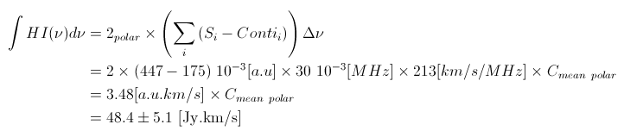

The HI line intensity
Integral in the range [1412-1413] MHz
Then
To be compared to 11.3 Jy/au
Or
3.48 x 11.3 = 39.3 [Jy.km/s]
To be compared to 48.4 Jy.km/s
3C161

Slide 22
NGC4383 Drift Scan
SCA157756.171
Date 2011-11-19
Cycles 2-15

Slide 23
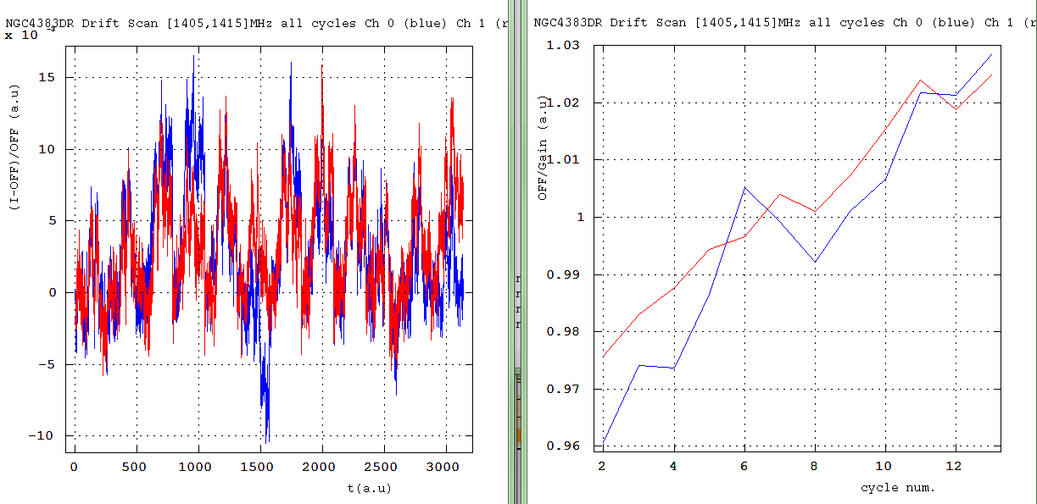
(I-OFF)/OFF
OFF/Gain
Variation ±3%

Slide 24
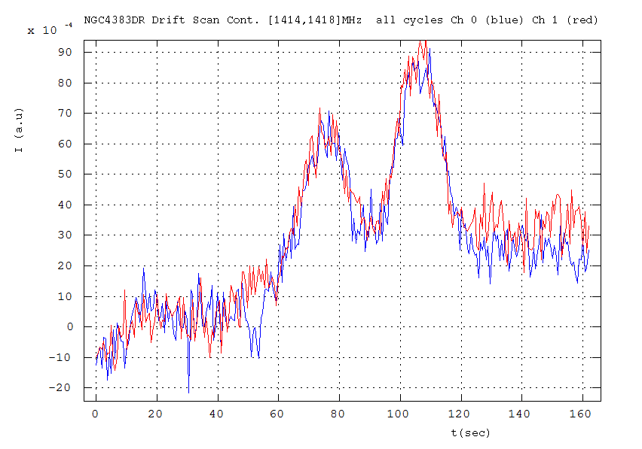
Continuum evolution

Slide 25
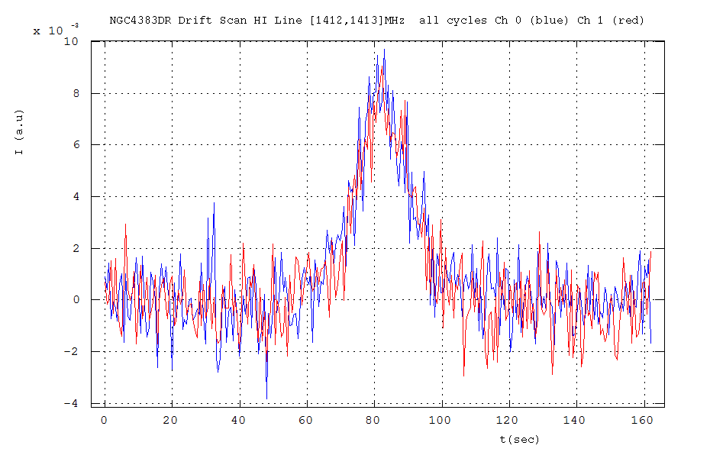
HI Line evolution
8 10⁻³
3C161
11.3Jy/au x 2 x 8 10⁻³ (au) = (181±5) mJy to be compared to (230±24m)Jy

Slide 26
Summary
3C161 @ 1410MHz gives 11.3±0.3 Jy/au
Overestimation of 3C273 continuum
Underestimation of HI NGC4383
Close to Ch 1 DAB (Est) calibrated thanks to PKS1127-14 WIBAR DAQ.
How to calibrate another freq. although the BAO spectra are quite stable in freq.

