Slide 1
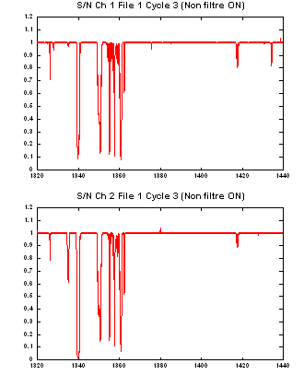
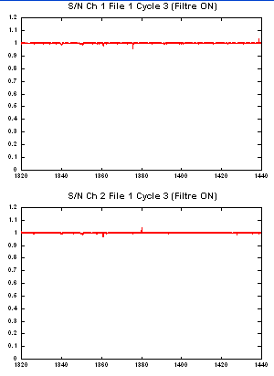
1.0
1.0
0.5
0.5
a)
b)
0.0
0.0
1320
1340
1360
1380
1400
1420
1440
1320
1340
1360
1380
1400
1420
1440
1.0
1.0
0.5
0.5
c)
d)
0.0
0.0
1320
1340
1360
1380
1400
1420
1440
1320
1340
1360
1380
1400
1420
1440

