Slide 1
PAON news: very preliminary
J.E Campagne
11th Oct. 12
TIANLAI video meeting

Slide 2
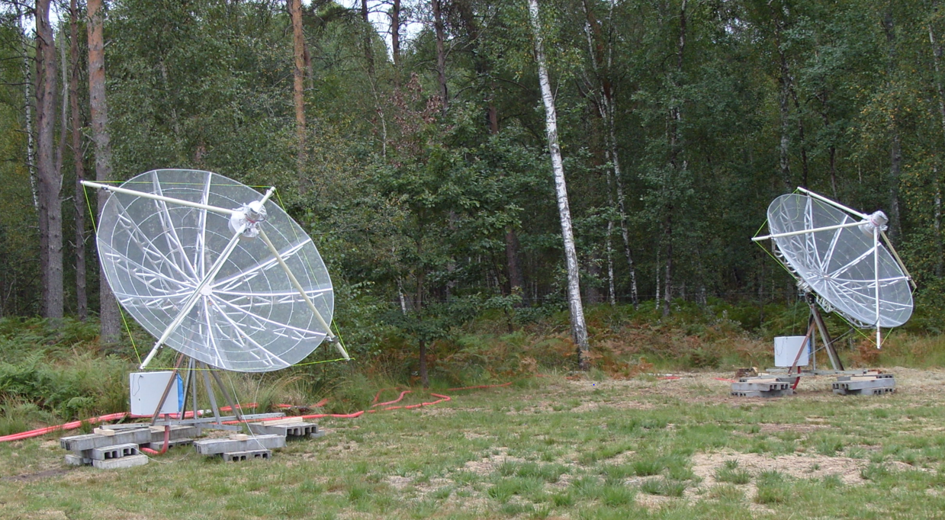
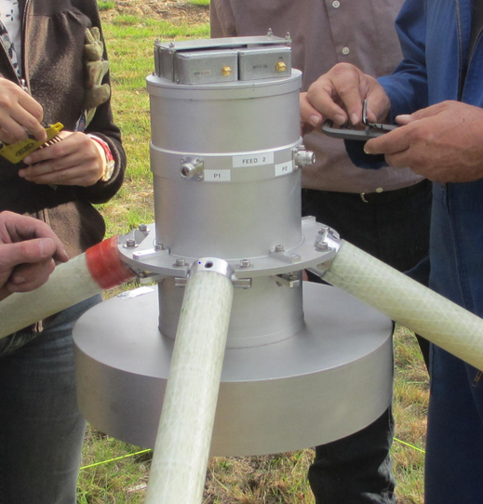

PAON: installed @ Nançay since 20th Sept. 12
3m
12m
East
West
Pointing to the Sun at local meridian at a given date (cf. manual pointing)
Daily data taken since 4th Oct. after correction of azimuth misalignment between the 2 dishes detected at first transit
FFT done in the FPGA and stored on disk online, while for the moment the visibilities are computed later (~150Go/50’, 4096 freq. bins [1250-1500]MHz, 1kHz trigger, integration over 2sec). Soon the visibilities will be computed online for long period of run.

Slide 3
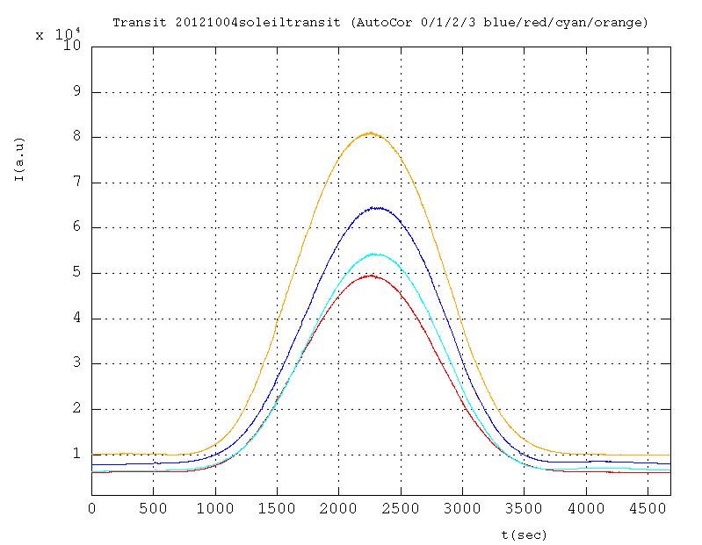
10⁴
Wv
T =1/2 S Aη/k
η~50%???, S~95sfu
T ~ 1200K
T_{tot} = T+T_{sysl}
Ev
Wh
Eh
T_{sys} ~ 170K
Feed-dish matching?
Dish efficiency?

Slide 4
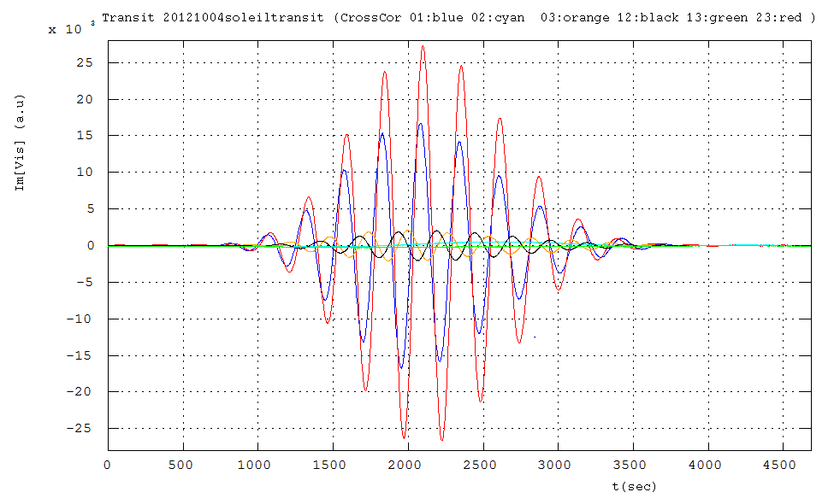
Im(Cross Corr)
10⁴
Wv-Ev
Wh-Eh
Wv-Eh
Ev-Wh
“Normal” interferences
Compatible with 5° misalignment relative rotation of the West and East feeds
Ev-Eh
Wv-Wh
Cross-talk between the 2 polarizations inside each feed

