Slide 1
Transit @ Nançay
JE. Campagne
16/5/2012

Slide 2
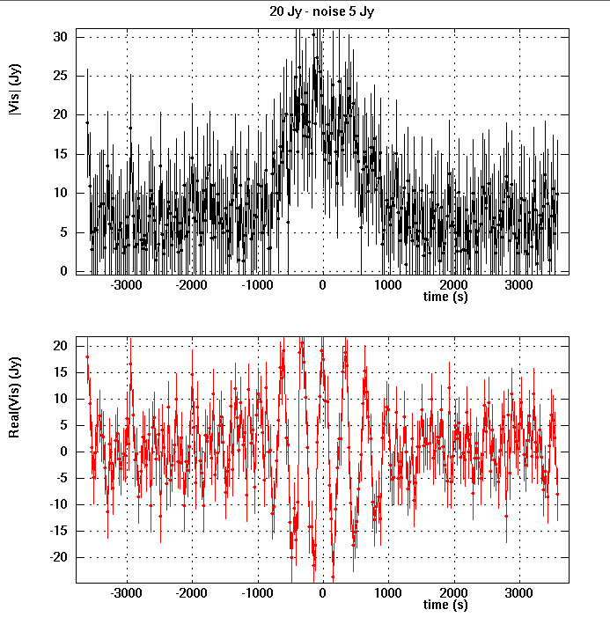
4 transits

Slide 3
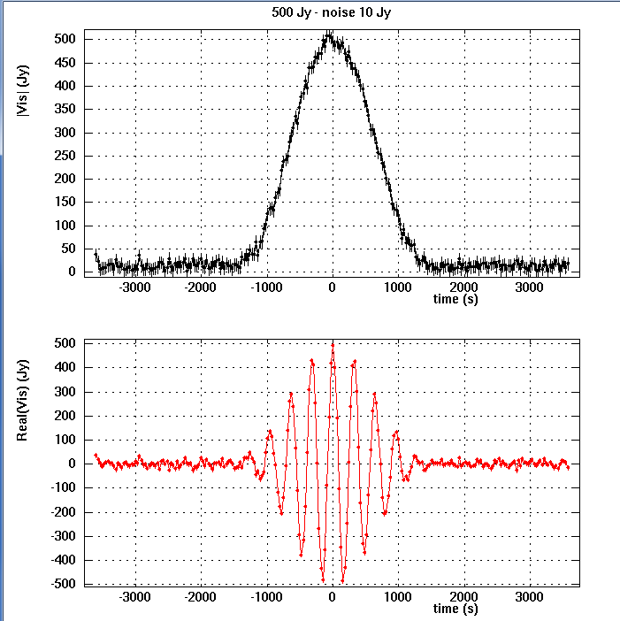

Slide 4
