Slide 1
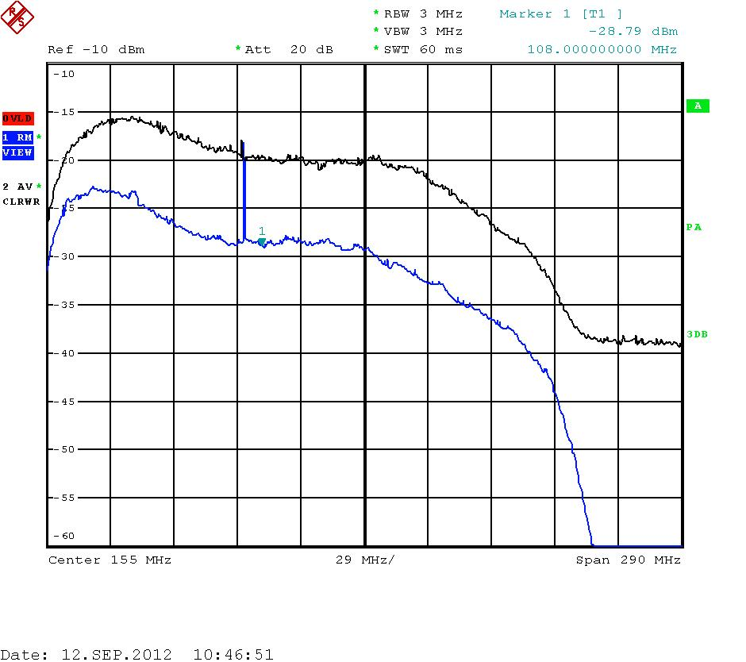
Electronic chain for dish test : Meudon(Sept 2012)
Dish
Inside the dish
Under the dish
In the mechanical room
LNA module
Amplifier module
RF Prototype Card (Version V1)
ADC
VME
PC
50 Ohms Cable
6 m length
75 Ohms Cable
50 m length
50 Ohms Cable
1 m length
Input ADC =10mV=-27DBm
With and without sun

